Slide 1
Midterm Report Create serverless applications
10727211 林彥輝
10727216 李品毅
Notes:
https://docs.microsoft.com/en-us/learn/paths/create-serverless-applications/

Slide 2
Intro
Model | 1 | 2 | 3 | 4 | 5 | 6 | 7 | 8 | 9 | 10 | 11
Sandbox | Intro |  |  |  |  |  |  |  |  |  | Local
110-1-CS456L | Intro |  |  |  |  |  |  |  |  |  | Local
 |  |  |  |  |  |  | VS (with lib) | Github | Node.js Core Tools VS Code (with lib) |  | Golang Azurite extension
Exercise
Schedule
2
2
2
2
2
80min
(Hands-on)
10min(Intro)
Azure Portal (110-1-CS456L)：https://portal.azure.com/#home
Microsoft Learn：https://docs.microsoft.com/en-us/learn/paths/create-serverless-applications/
Notes:
Visual Studio : （官方教程預設版本：VS 2019 Community）
載點：https://docs.microsoft.com/zh-tw/visualstudio/releases/2019/release-notes
接著安裝’ASP.NET and web development’ 和 ‘Azure development’ 套件
(流程參考https://docs.microsoft.com/en-us/learn/modules/develop-test-deploy-azure-functions-with-visual-studio/2-develop-and-test-azure-functions-locally)
－－－－－－－－－－－－－－－－－－－－－－－－－－－－－－－－－－－－－－－－－－－－－－－－－－－－－－－－－－－－－－－－－－－－－－－－－－－－－－－－－
Github：
網址：https://github.com/ （請先申請一個帳號）
－－－－－－－－－－－－－－－－－－－－－－－－－－－－－－－－－－－－－－－－－－－－－－－－－－－－－－－－－－－－－－－－－－－－－－－－－－－－－－－－－
Node.js：
載點：https://nodejs.org/download/release/v14.18.1/
（相容性需求：請安裝14版的）
－（Windows：node-v14.18.1-x64.msi）
－（MacOS：node-v14.18.1.pkg ）
Azure Functions Core Tools：
載點：https://github.com/Azure/azure-functions-core-tools
（v3版本佳）
Visual Studio：
載點：https://code.visualstudio.com/download
接著延伸模組區（預設快捷鍵：Ctrl+Shift+X）
安裝‘Azure Functions extension for Visual Studio Code’ 和 ‘Azure Storage extension for Visual Studio Code’套件
－－－－－－－－－－－－－－－－－－－－－－－－－－－－－－－－－－－－－－－－－－－－－－－－－－－－－－－－－－－－－－－－－－－－－－－－－－－－－－－－
Golang ：
載點：https://go.dev/dl/
Azurite extension：
載點：https://marketplace.visualstudio.com/items?itemName=Azurite.azurite
－－－－－－－－－－－－－－－－－－－－－－－－－－－－－－－－－－－－－－－－－－－－－－－－－－－－－－－－－－－－－－－－－－－－－－－－－－－－－－－－

Slide 3
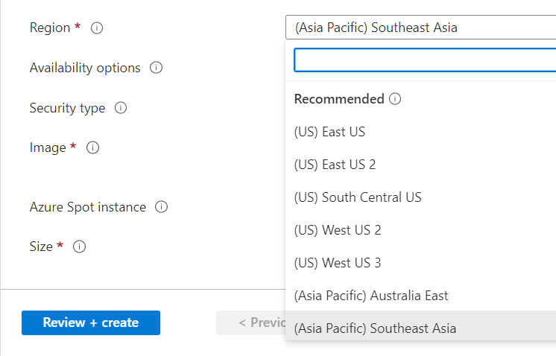
Intro
本報告279頁，請把PPT載下來對照（台上只講大流程）
Region （不要通通集中在Japan East）
Resource Naming Rule （記得學號開頭）
備忘稿要看，裡面有提醒 （有code、截圖提示！）
Another Resource：https://www.youtube.com/playlist?list=PLMXvlcTmSbxHVQ2pUfZkgyu_0mum7jiKH
Sandbox Demo Video （Model 2 3 4 5 6 8 ，~103min）
Notes:
打開Azure Portal

Slide 4
01
Choose the best Azure service to automate your business processes

Slide 5

Azure Functions
https://docs.microsoft.com/en-us/learn/modules/create-serverless-logic-with-azure-functions/2-decide-if-serverless-computing-is-right-for-your-business-need
https://docs.microsoft.com/en-us/learn/modules/build-serverless-api-with-functions-api-management/2-import-function-app-api-management
What is serverless compute?
Serverless compute can be thought of as a function as a service (FaaS), or a microservice that is hosted on a cloud platform. You don't have to manually provision or scale infrastructure. The cloud provider manages infrastructure. Your app is automatically scaled out or down depending on load.
What is Azure Functions?
Azure Functions is a service that enables serverless architectures in Azure. You can write functions, without worrying about the supporting infrastructure, in many different languages, including C#, Java, JavaScript, PowerShell, and Python. You can also use libraries from NuGet and the Node Package Manager (NPM), and authenticate users with the OAuth standard from providers such as Active Directory, Facebook, Google, and Microsoft Account.
Benefits
1. Avoids over-allocation of infrastructure
2. Stateless logic
3. Event driven
4. Functions can be used in traditional compute environments

Slide 6

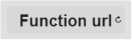


Azure Functions
SaaS
PaaS
IaaS
FaaS

Slide 7
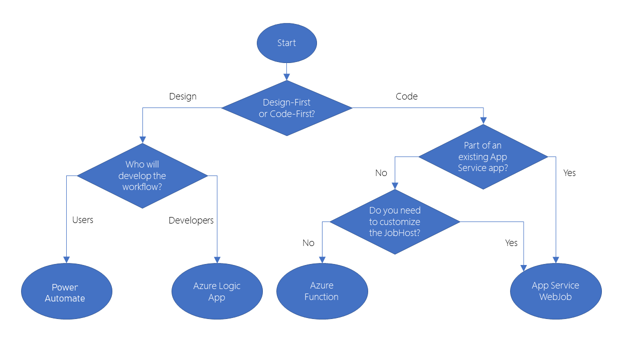
Choose a Azure Serverless Service
https://docs.microsoft.com/en-us/learn/modules/choose-azure-service-to-integrate-and-automate-business-processes/3-analyze-the-decision-criteria

Slide 8
02
Create serverless logic with Azure Functions

Slide 9
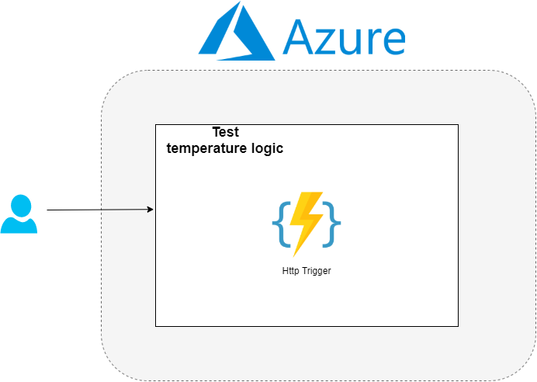
Abstract
Notes:
創建HttpTrigger
測試

Slide 10
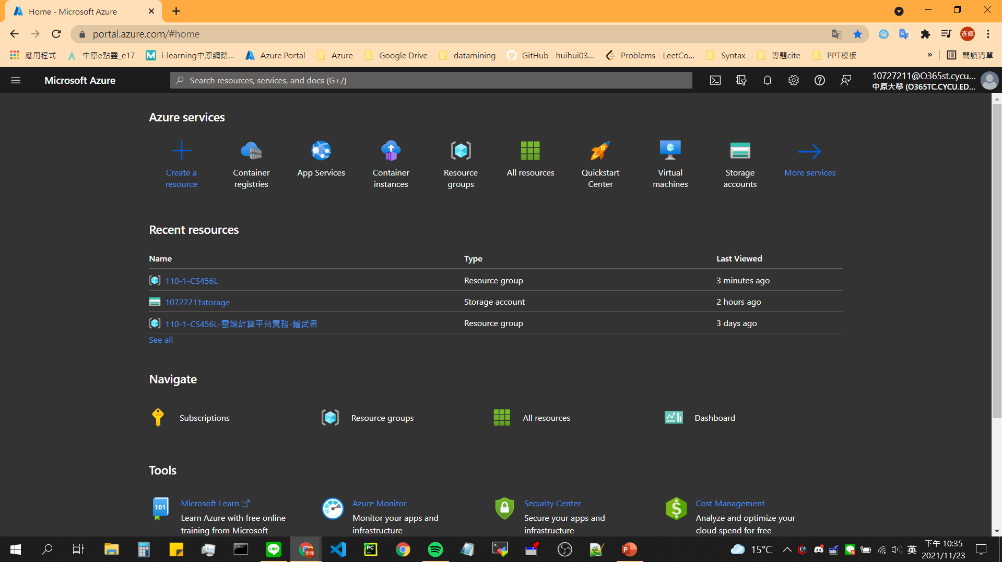
Create Azure Function in the Azure Portal

Slide 11
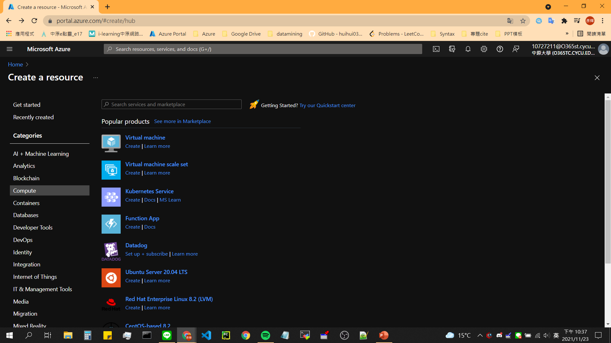

Slide 12
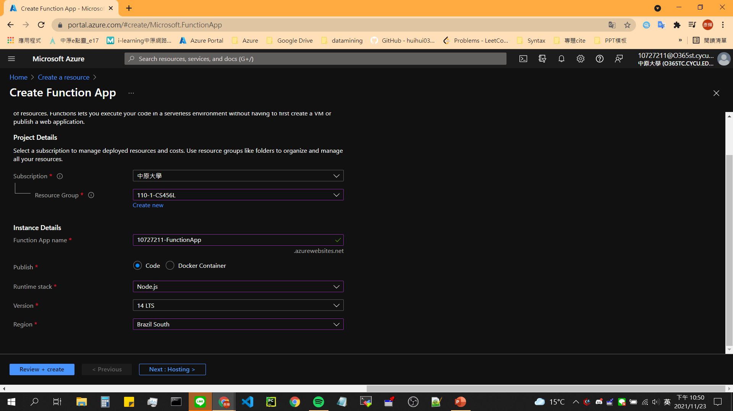

Slide 13
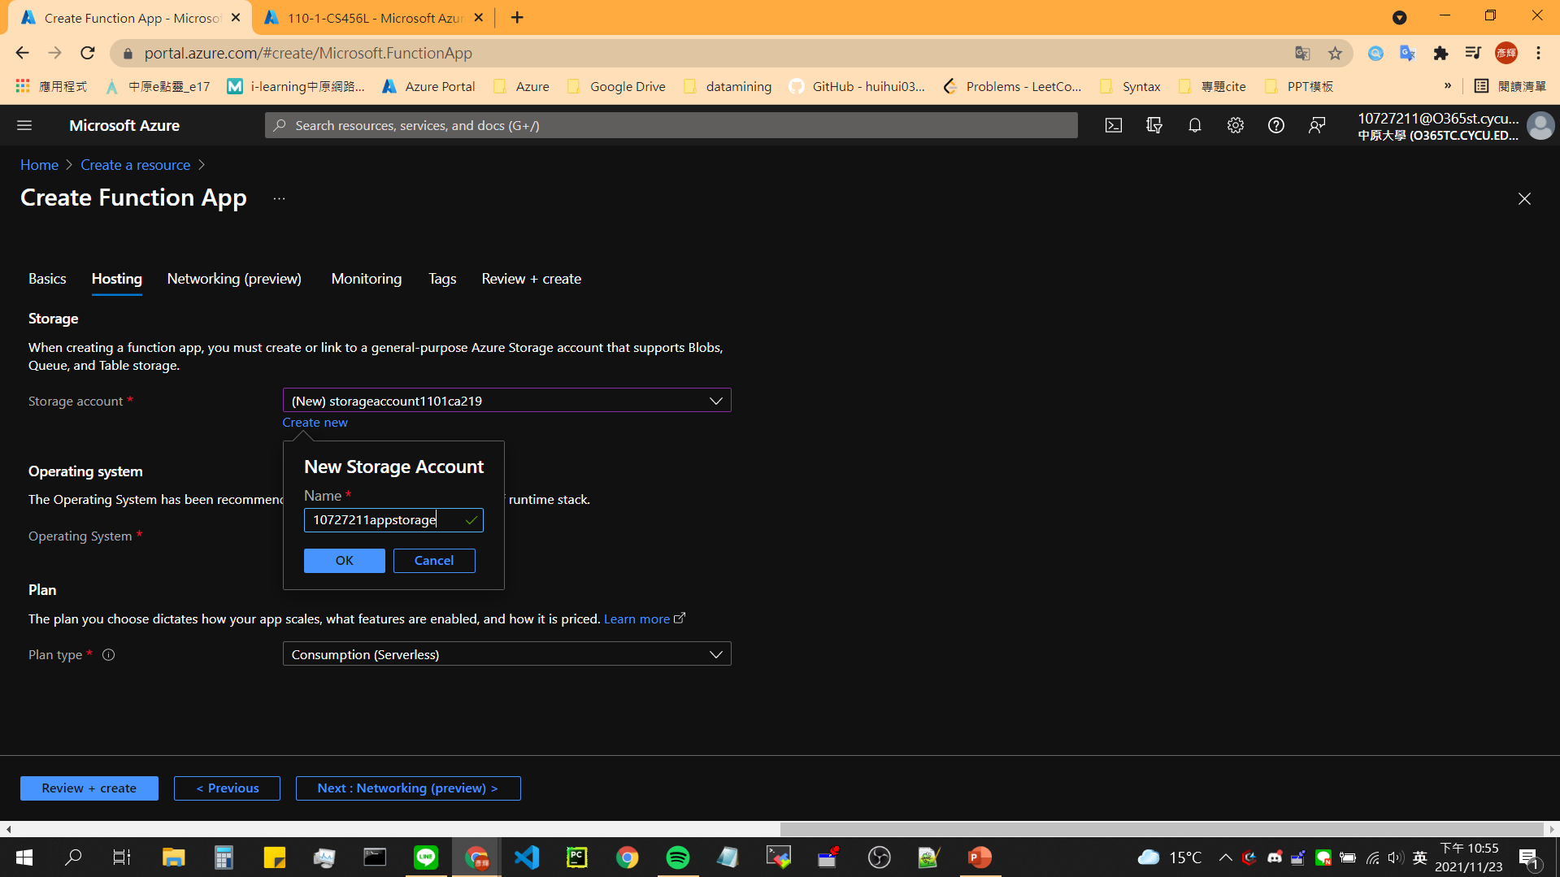

Slide 14
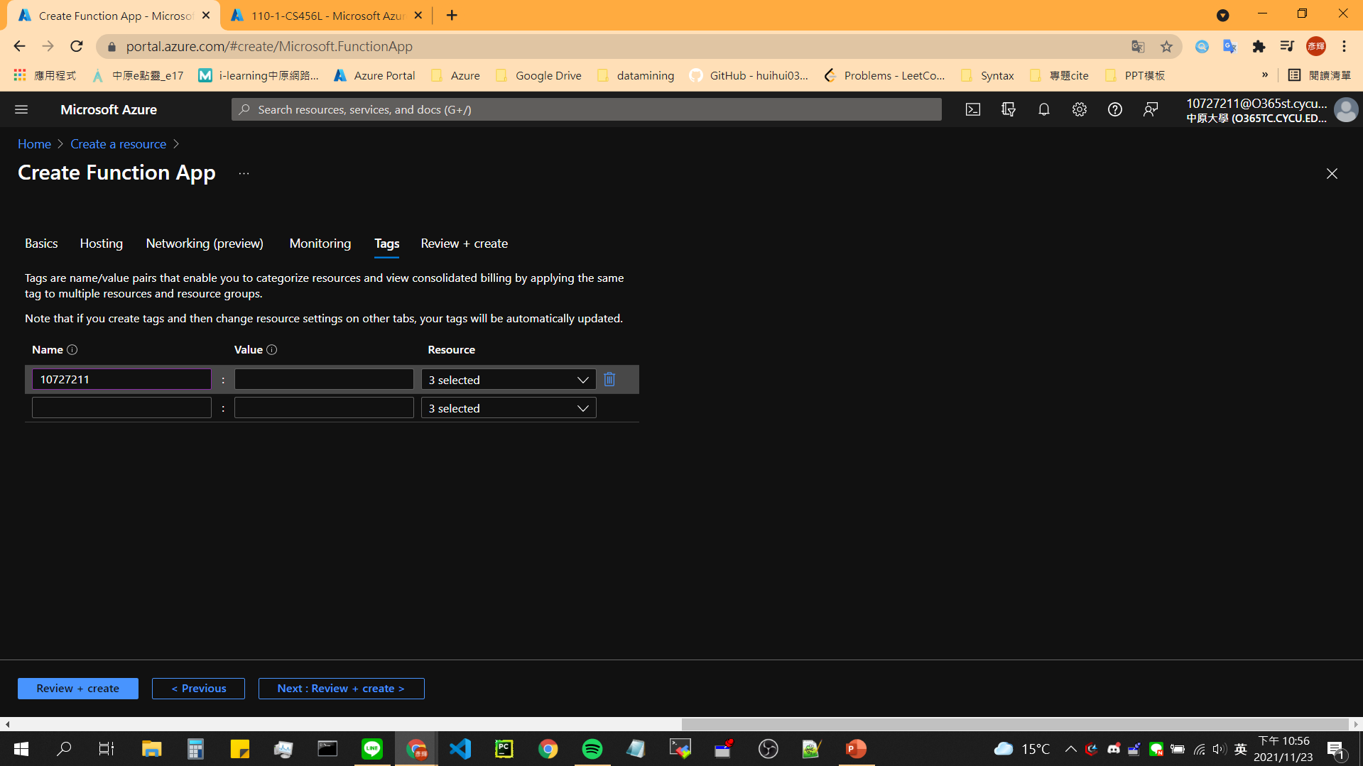

Slide 15
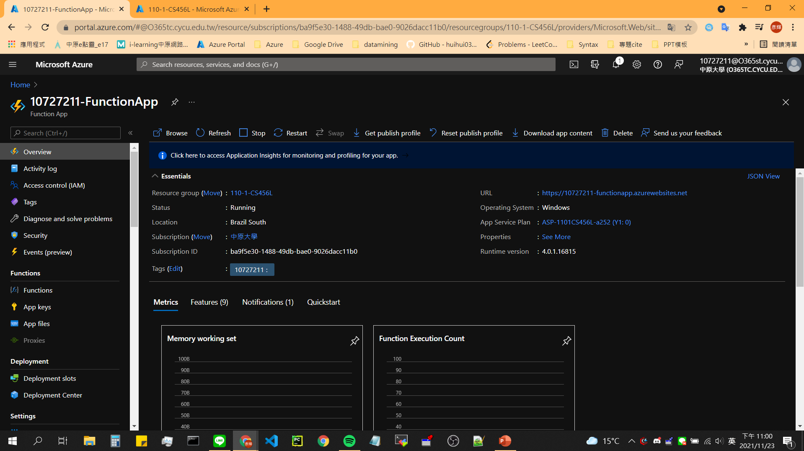
Notes:
截圖!

Slide 16
Add a function to your function app

Slide 17
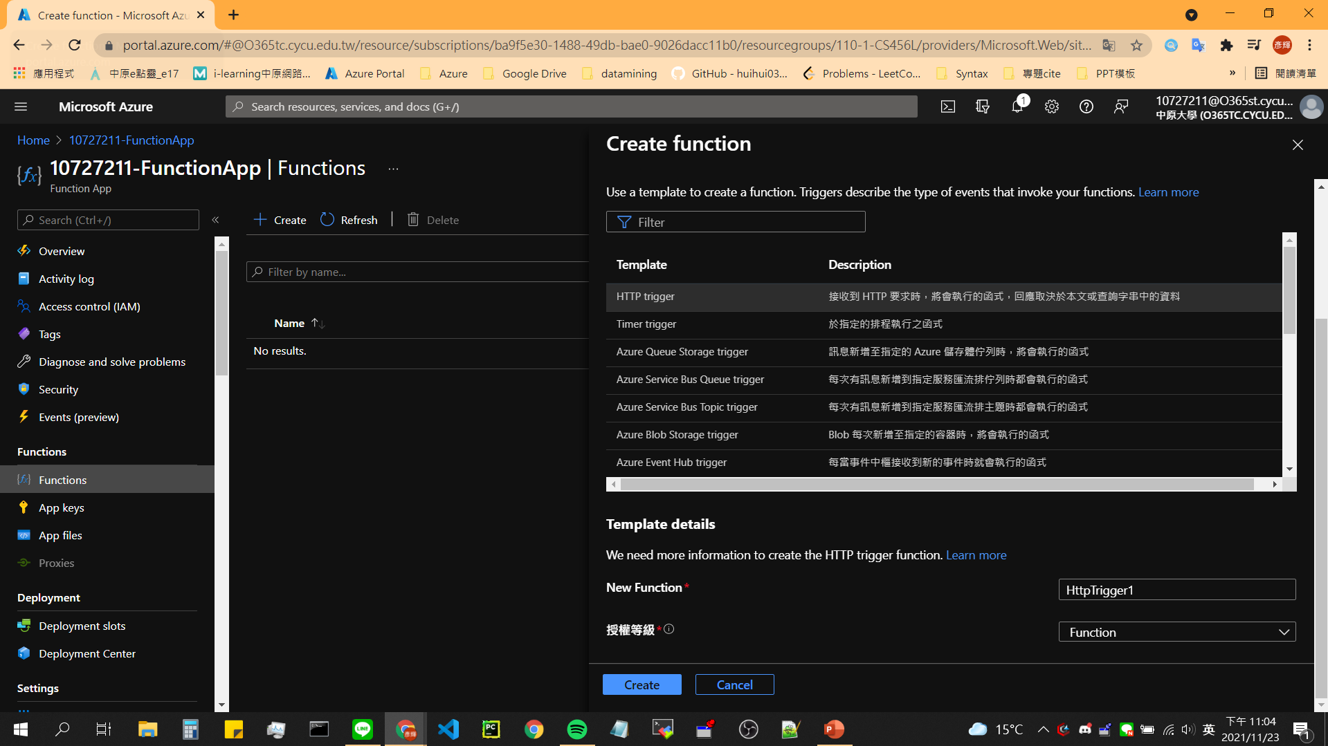

Slide 18
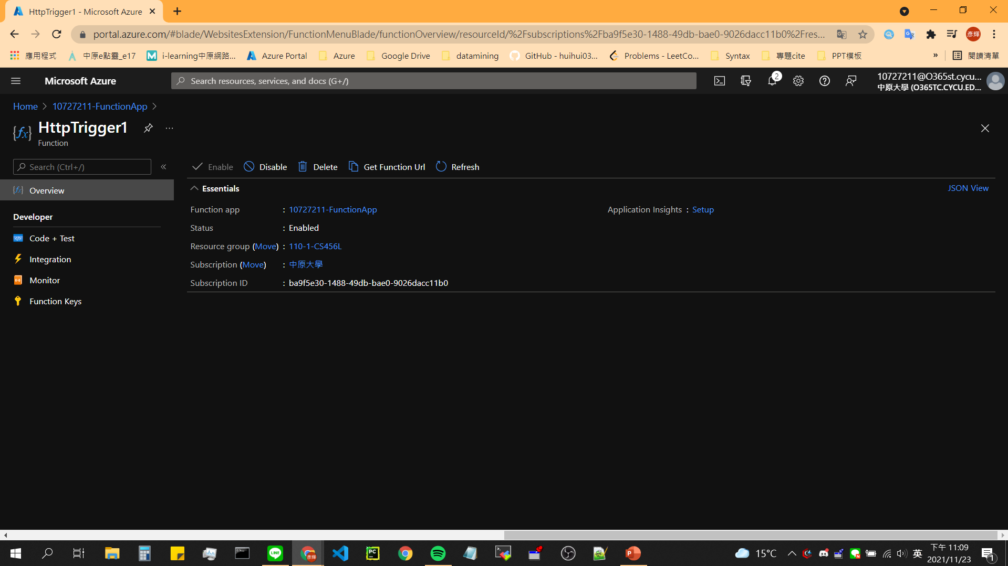
Notes:
截圖!

Slide 19
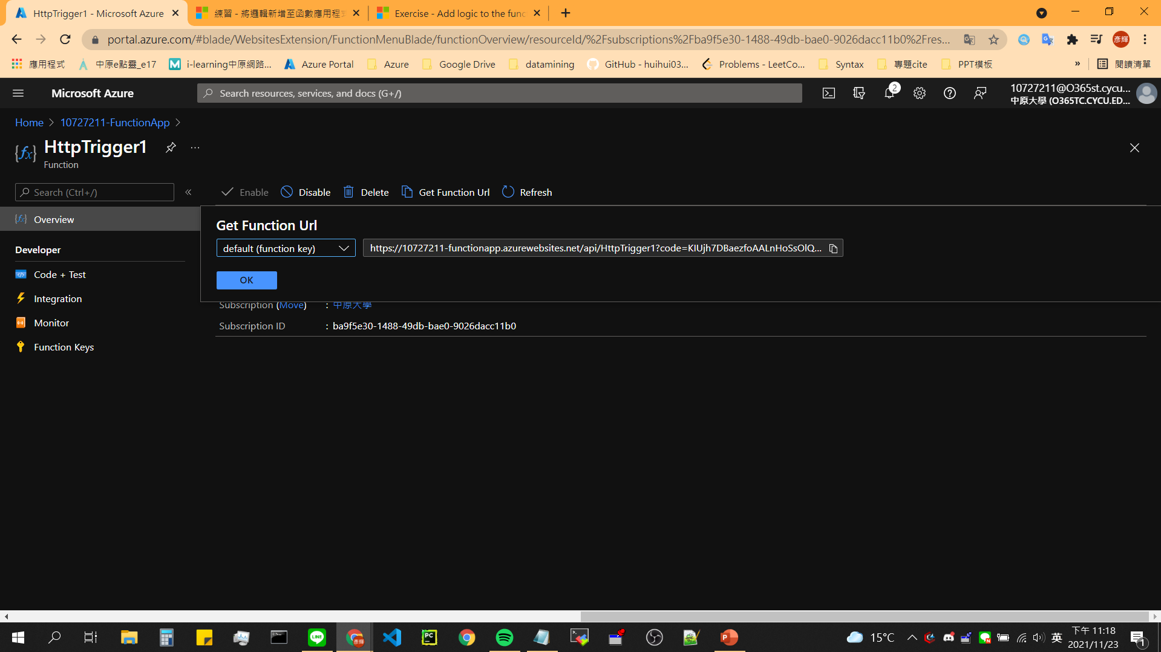
Get Function URL
Store-1

Slide 20
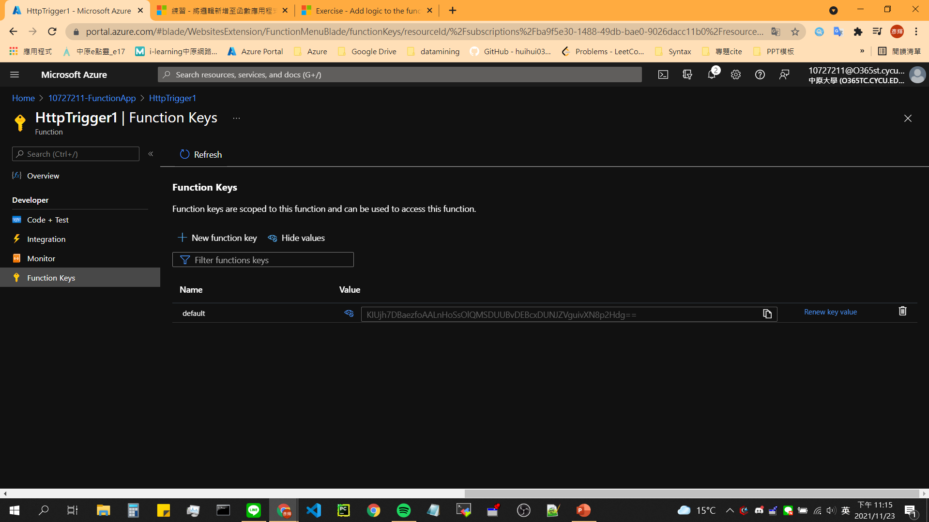
Secure HTTP triggers
Store-2

Slide 21
Test Function
curl --header "Content-Type: application/json" --header "x-functions-key: <your-function-key>" --request POST --data "{\"name\": \"Azure Function\"}" <your-https-url>
Replace
curl --header "Content-Type: application/json" --header "x-functions-key: KIUjh7DBaezfoAALnHoSsOlQMSDUUBvDEBcxDUNJZVguivXN8p2Hdg==" --request POST --data "{\"name\": \"Azure Function\"}" https://10727211-functionapp.azurewebsites.net/api/HttpTrigger1?code=KIUjh7DBaezfoAALnHoSsOlQMSDUUBvDEBcxDUNJZVguivXN8p2Hdg==

Slide 22
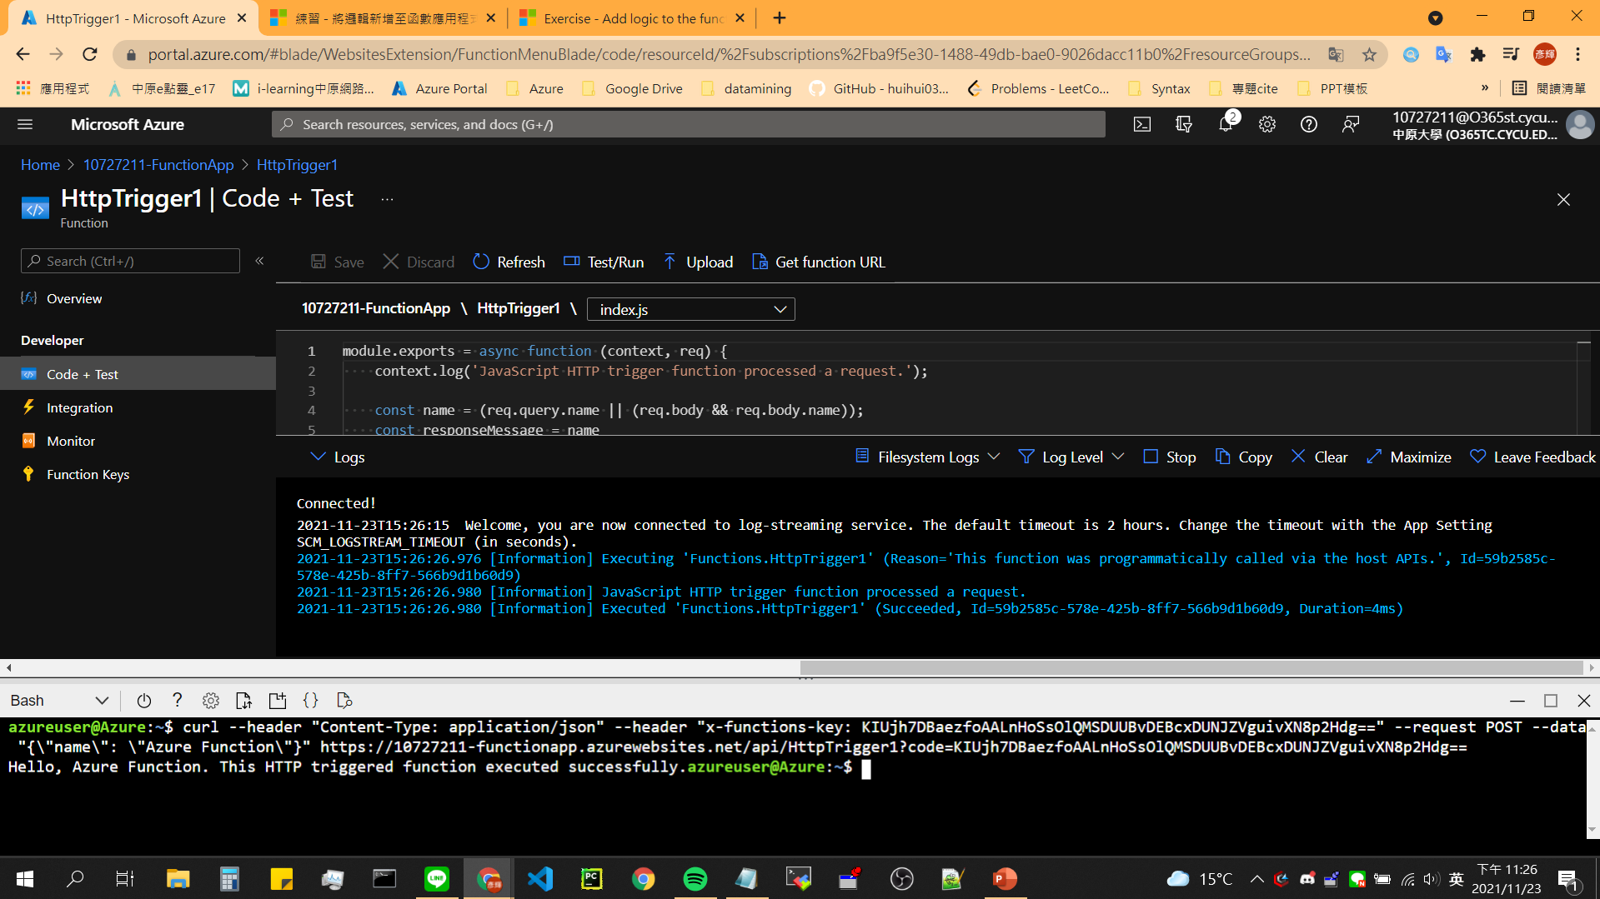
Test Function - 1
Notes:
截圖!

Slide 23
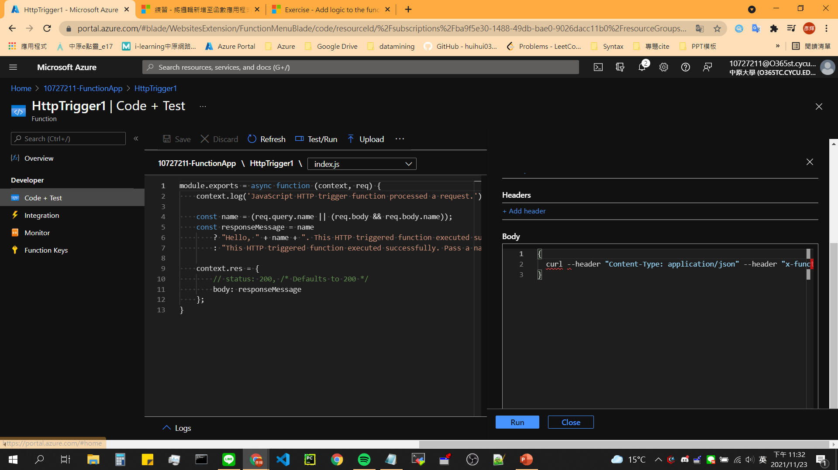
Test Function - 2

Slide 24
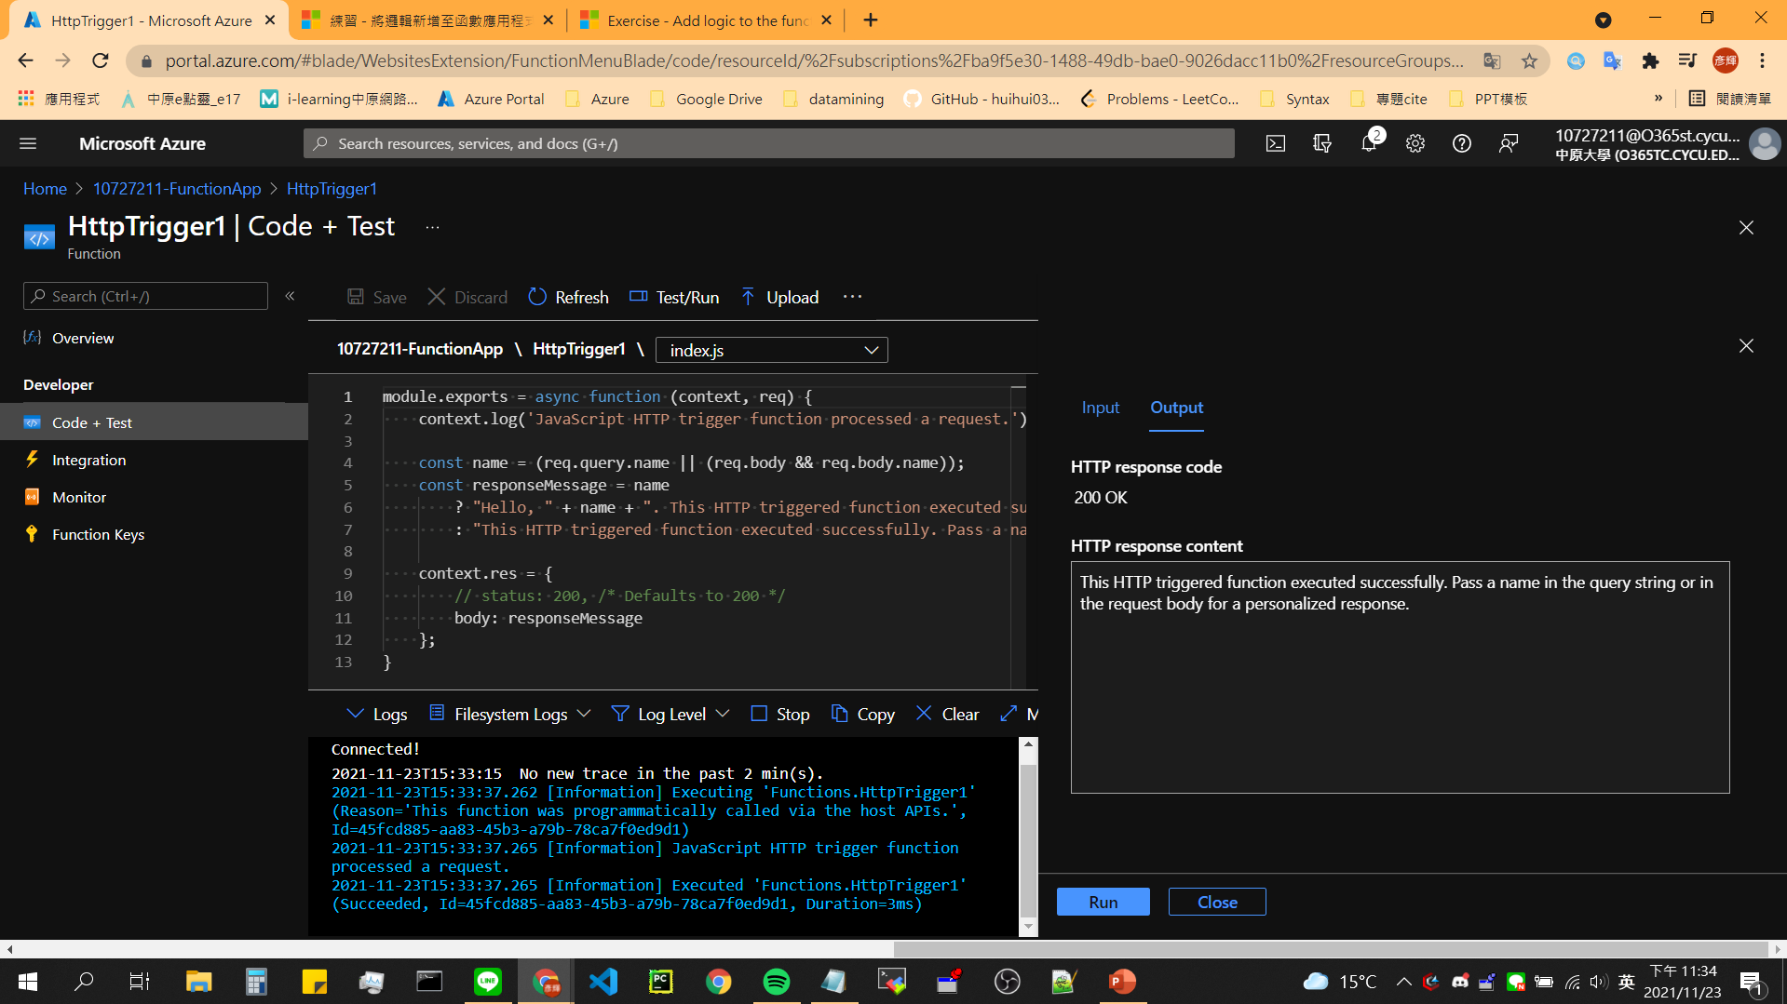
Test Function - 2
Notes:
截圖!

Slide 25
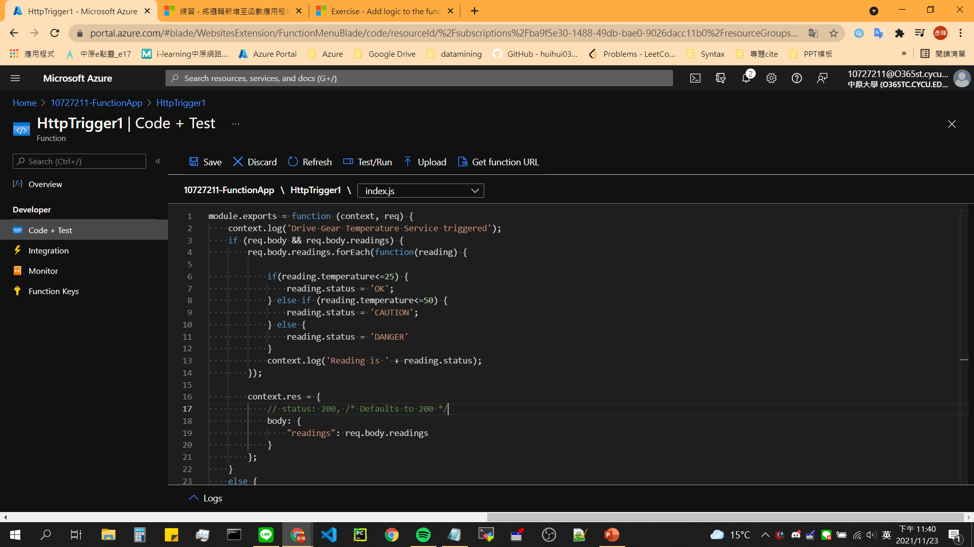
Replace index.js
Notes:
module.exports = function (context, req) {
context.log('Drive Gear Temperature Service triggered');
if (req.body && req.body.readings) {
req.body.readings.forEach(function(reading) {
if(reading.temperature<=25) {
reading.status = 'OK';
} else if (reading.temperature<=50) {
reading.status = 'CAUTION';
} else {
reading.status = 'DANGER'
}
context.log('Reading is ' + reading.status);
});
context.res = {
// status: 200, /* Defaults to 200 */
body: {
"readings": req.body.readings
}
};
}
else {
context.res = {
status: 400,
body: "Please send an array of readings in the request body"
};
}
context.done();
};

Slide 26
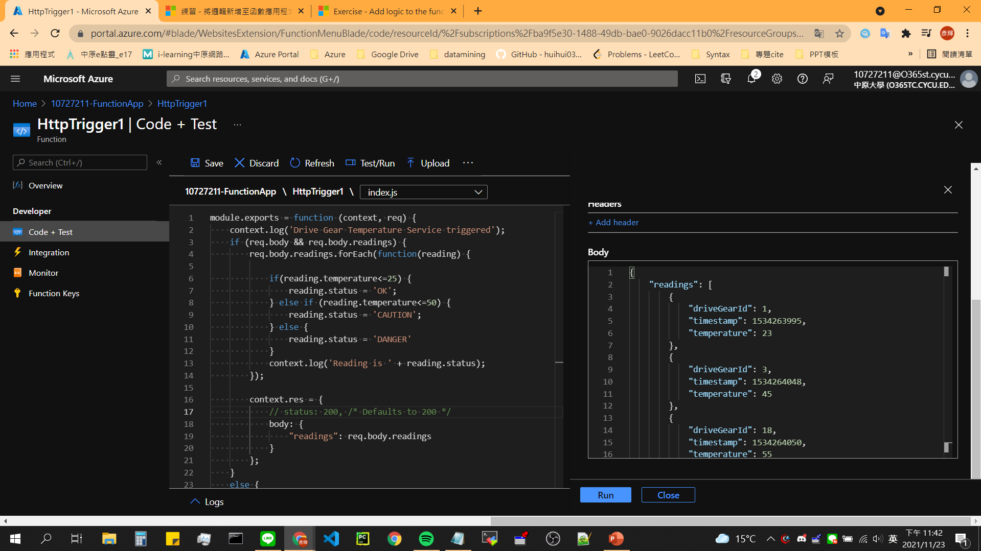
Replace Test Body
Notes:
{
"readings": [
{
"driveGearId": 1,
"timestamp": 1534263995,
"temperature": 23
},
{
"driveGearId": 3,
"timestamp": 1534264048,
"temperature": 45
},
{
"driveGearId": 18,
"timestamp": 1534264050,
"temperature": 55
}
]
}

Slide 27
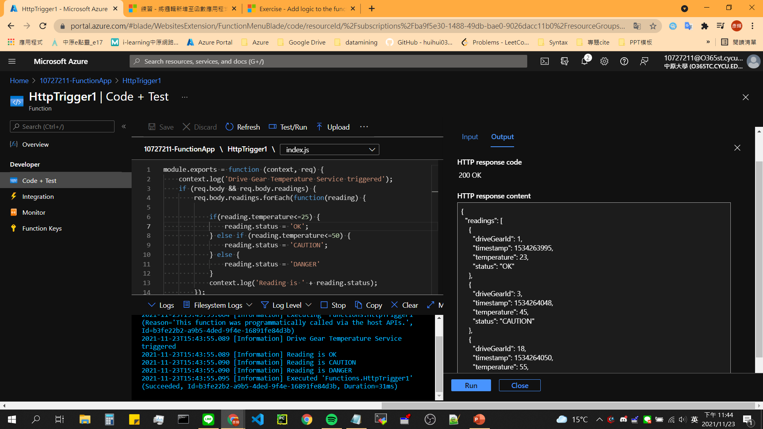
Result
Notes:
截圖!

Slide 28
03
Execute an Azure Function with triggers

Slide 29
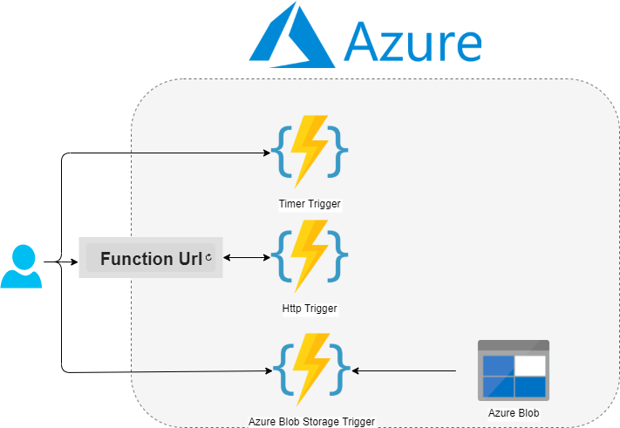
Abstract

Slide 30
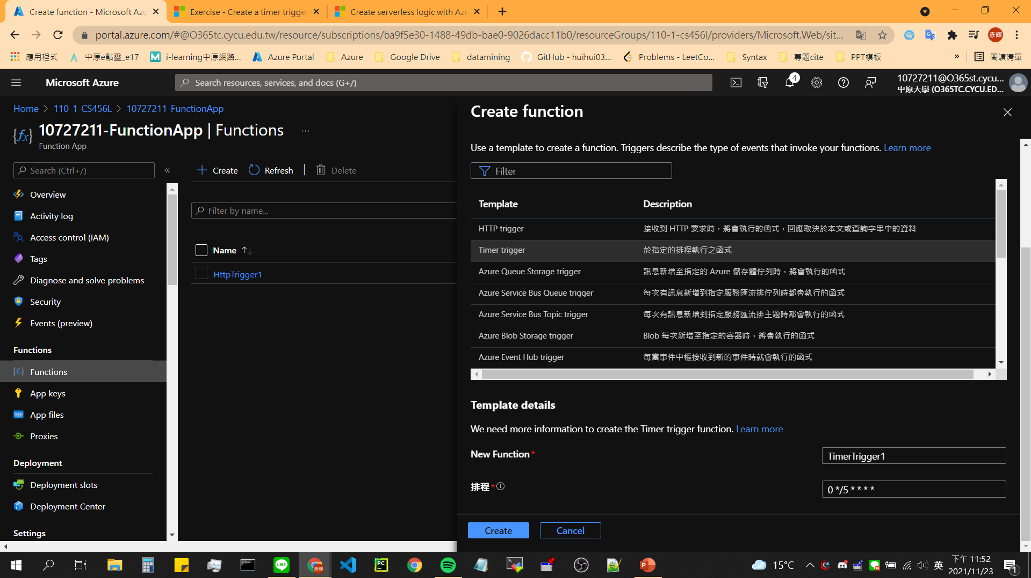
Create a timer-triggered function

Slide 31
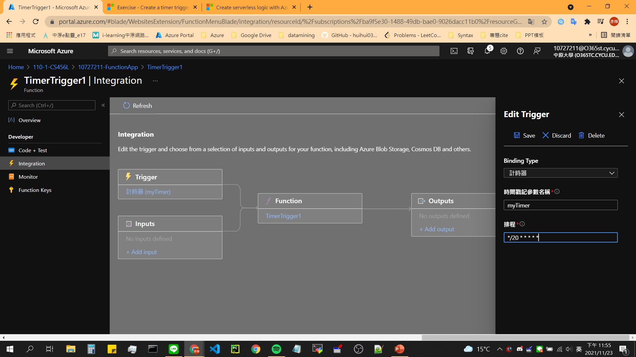
Configure the timer trigger

Slide 32
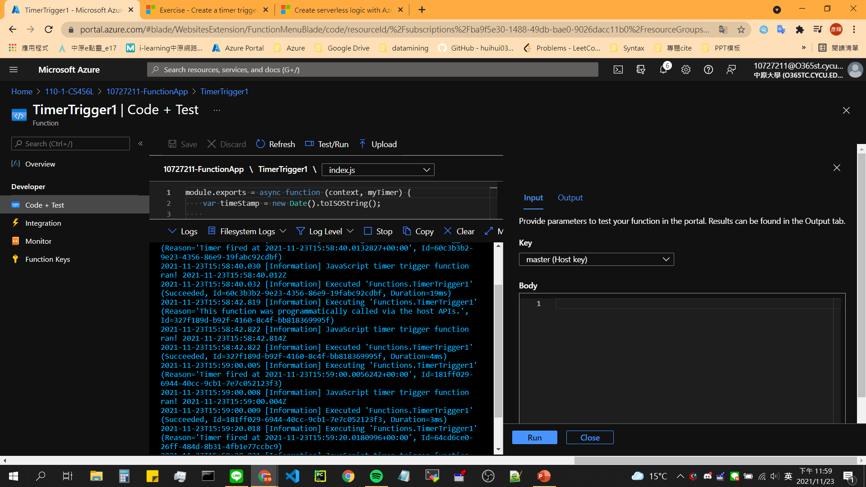
Test the timer
Notes:
截圖!

Slide 33
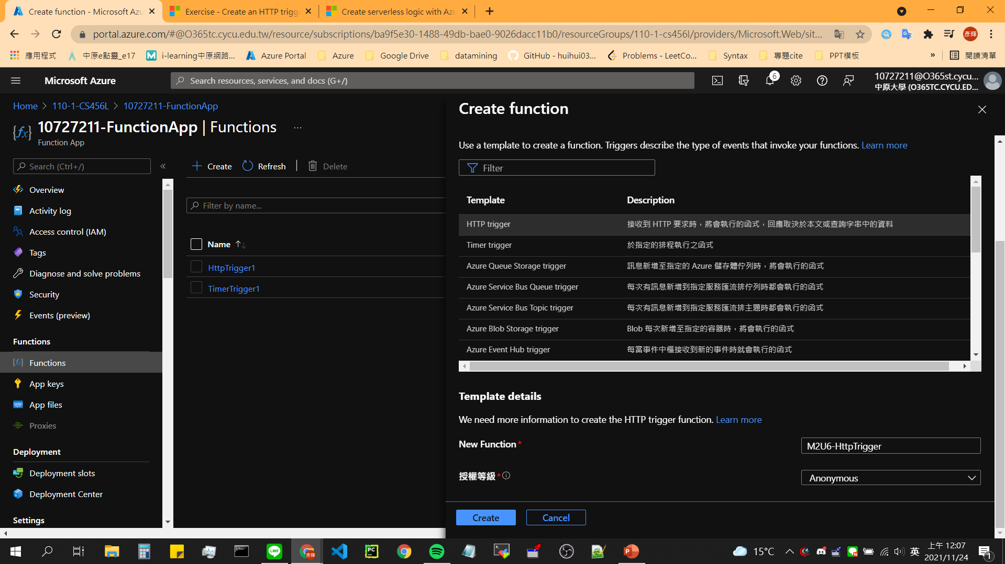
Create a http-triggered function

Slide 34
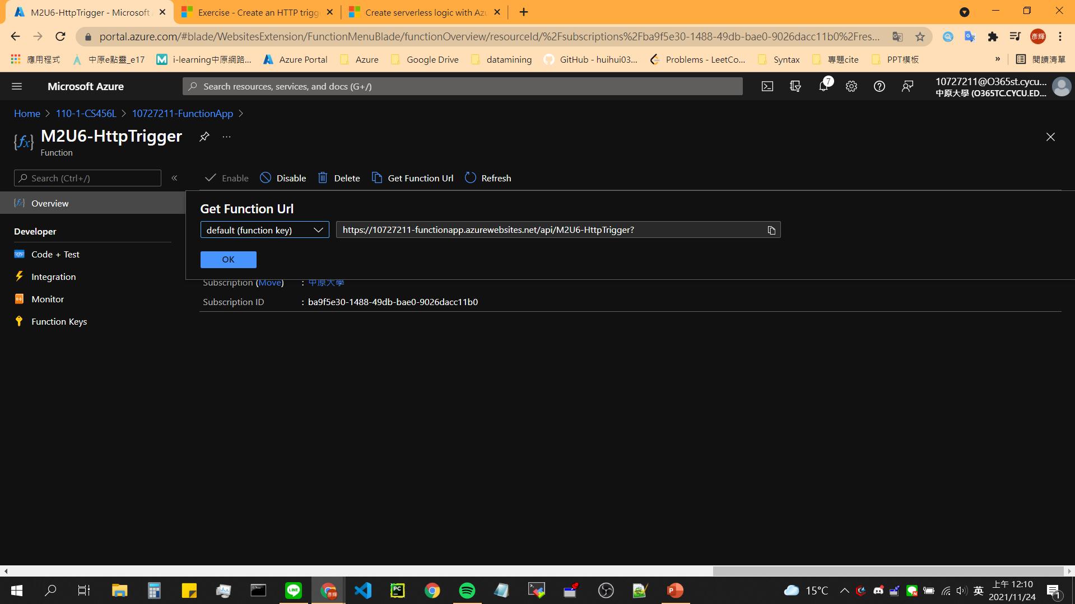
Get Function Url

Slide 35
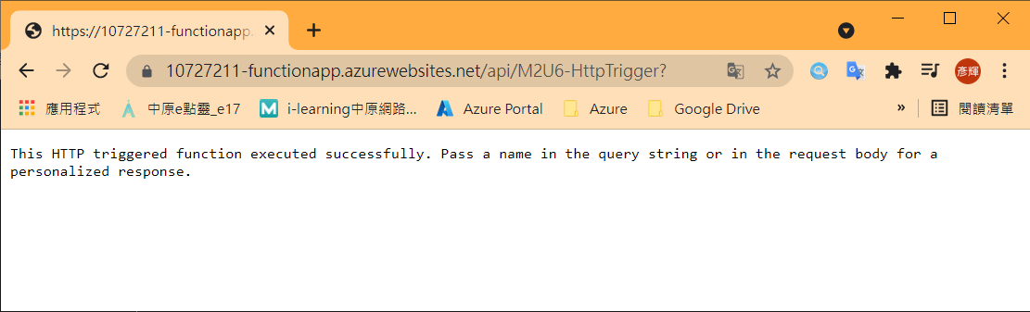
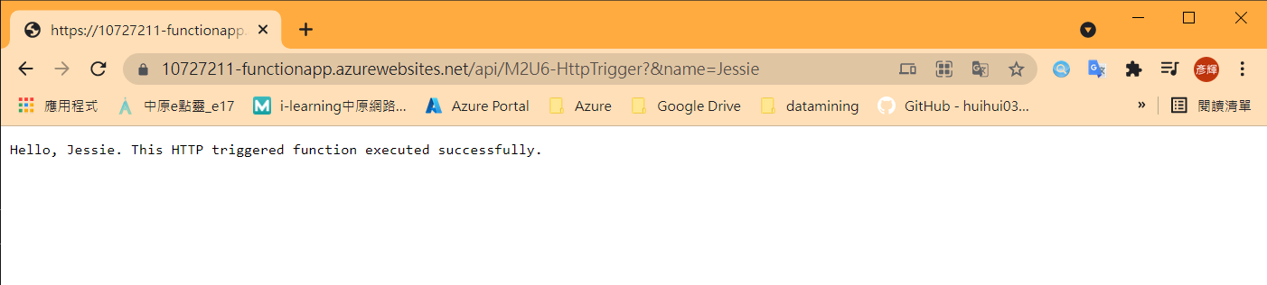
Test Function Url
Notes:
截圖!

Slide 36
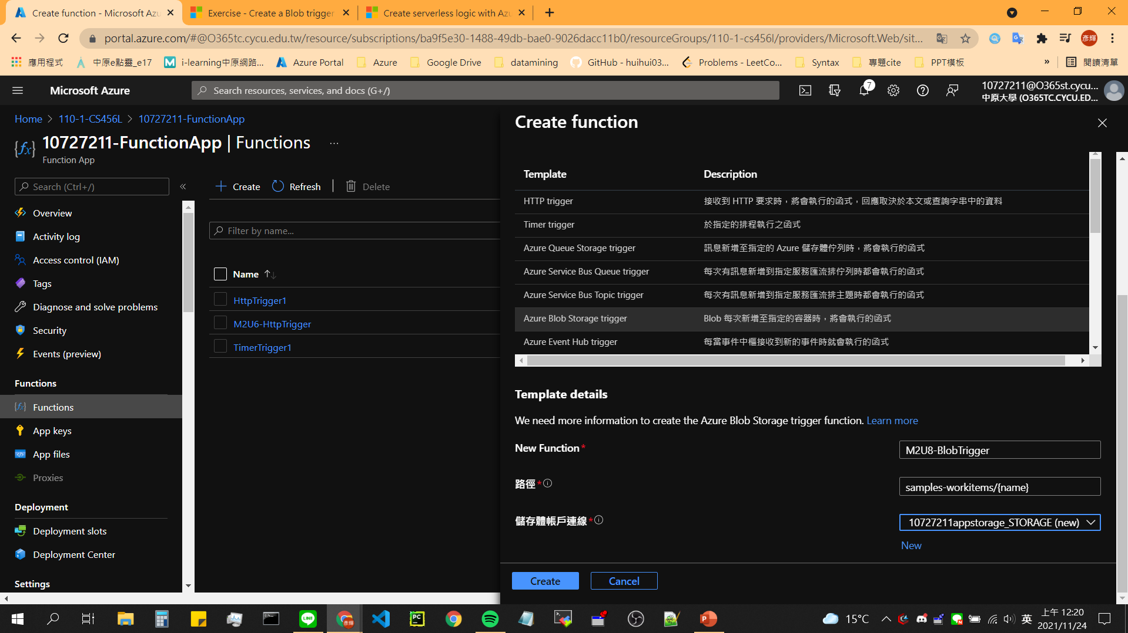
Create a blog trigger

Slide 37
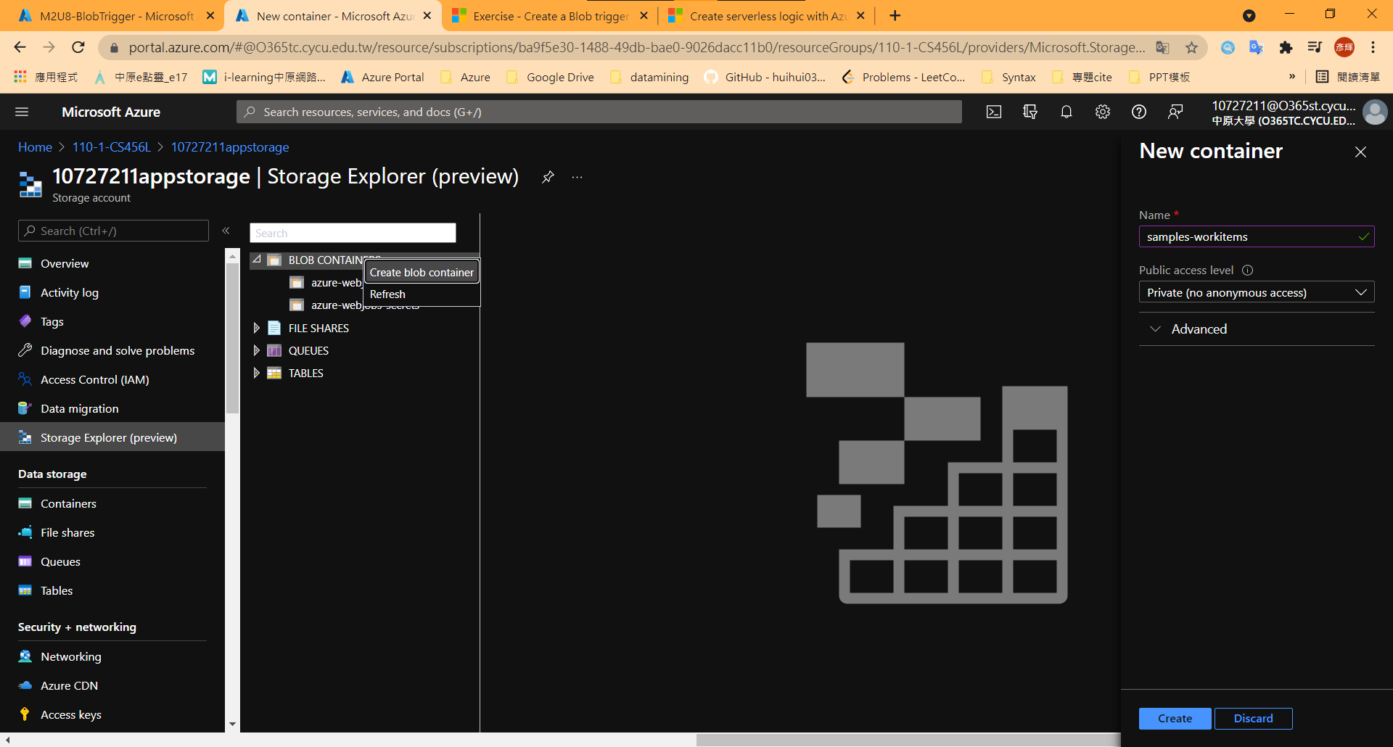
Create a blog container (create new tab)

Slide 38
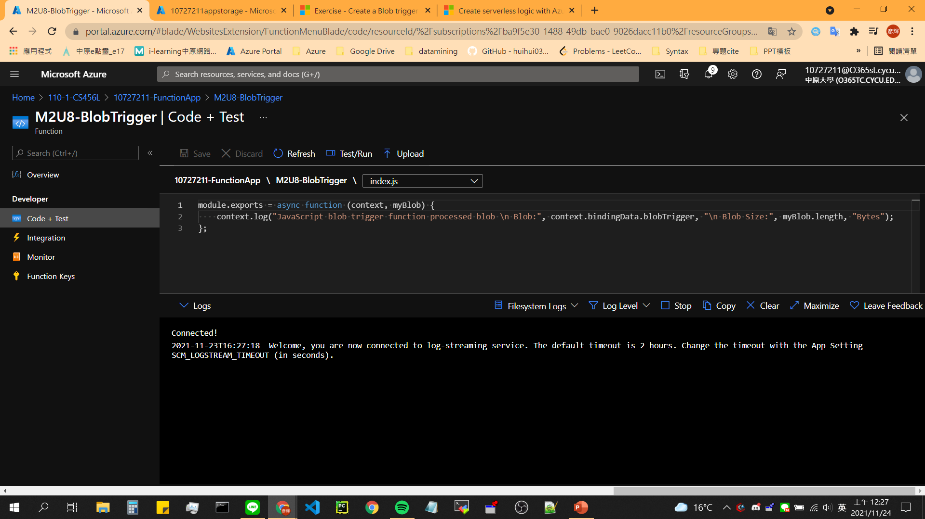
Turn on your blog trigger

Slide 39
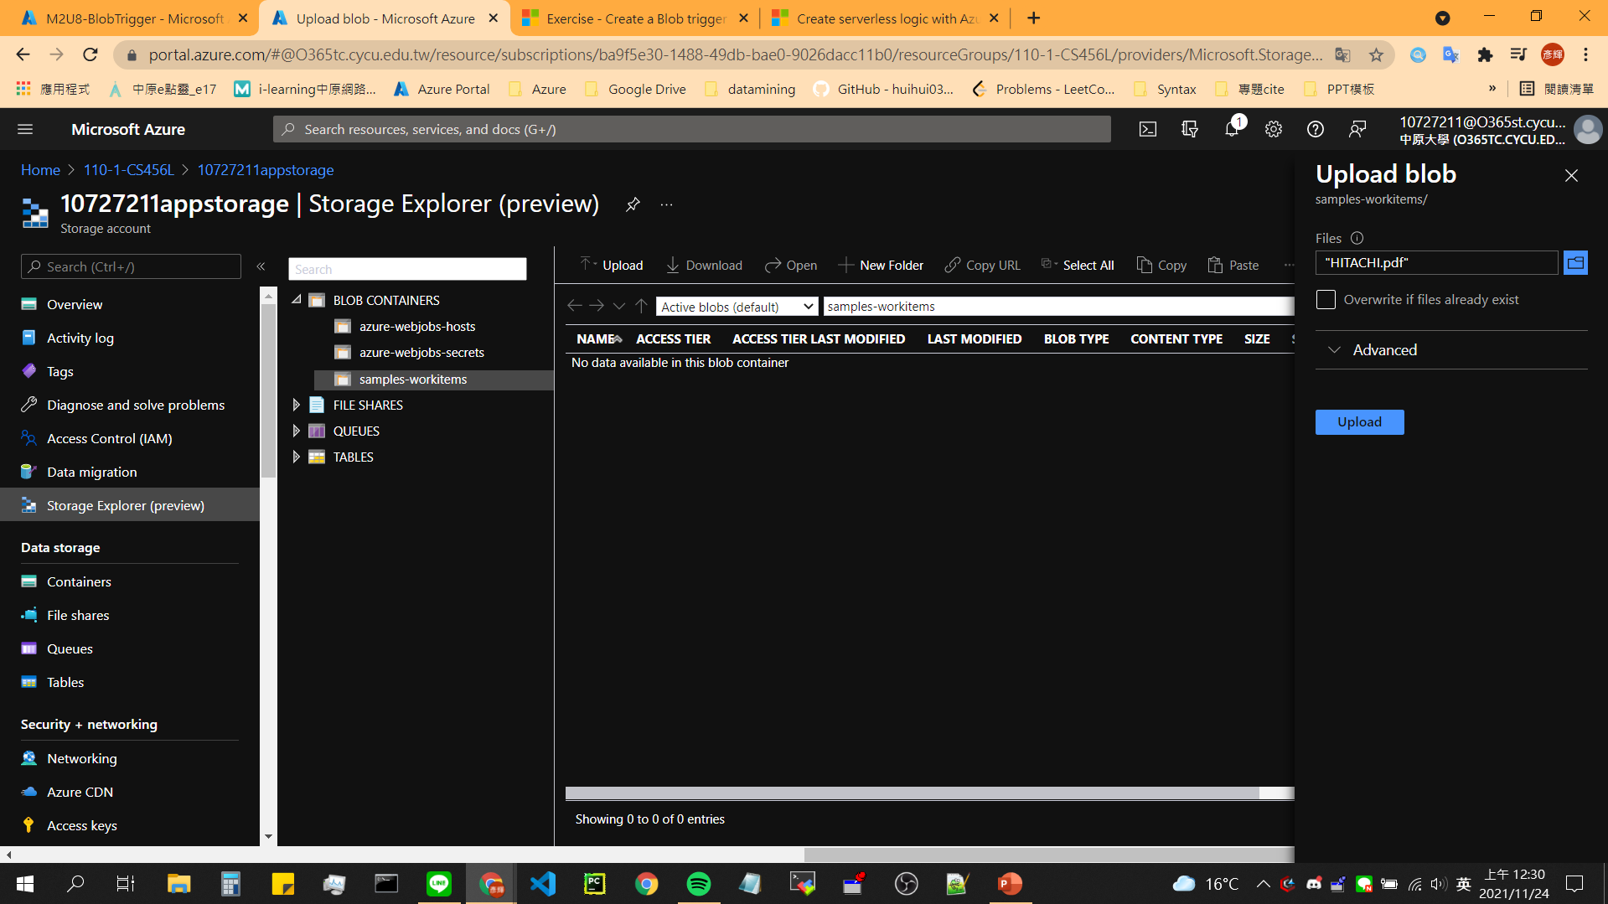
Create a blob

Slide 40
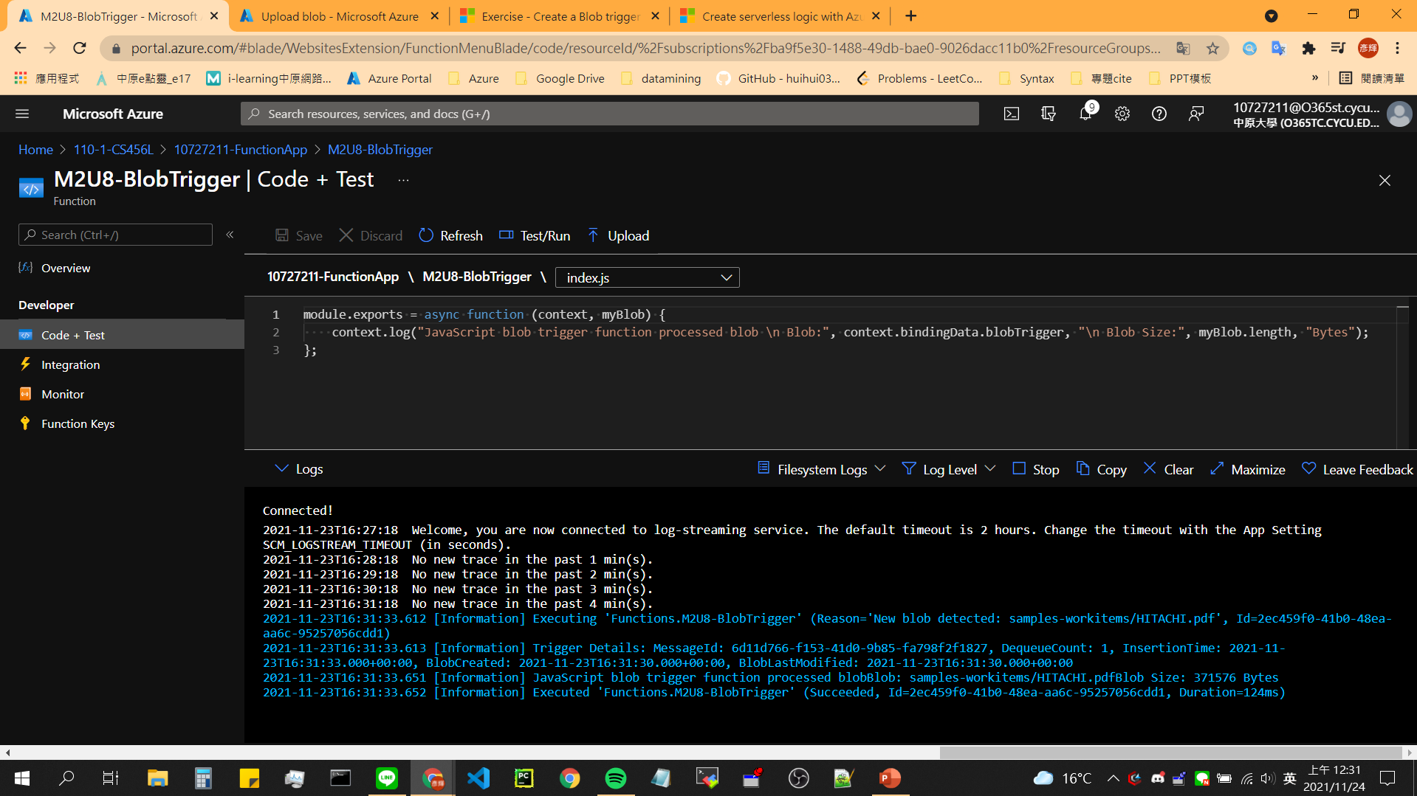
Result
Notes:
截圖!

Slide 41
04
Chain Azure Functions together using input and output bindings

Slide 42
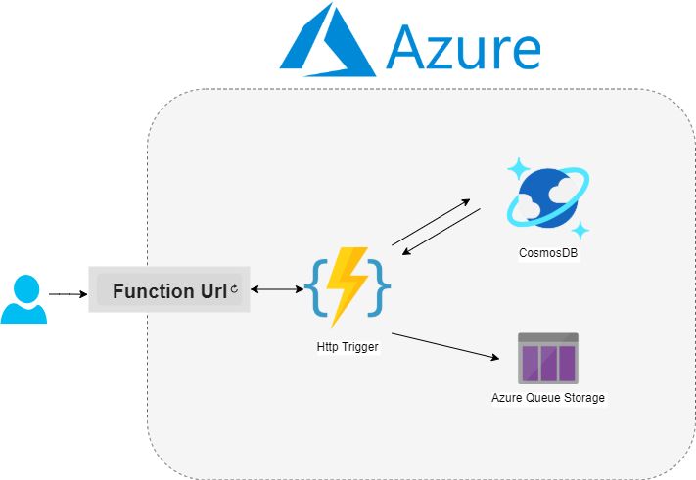
Abstract

Slide 43
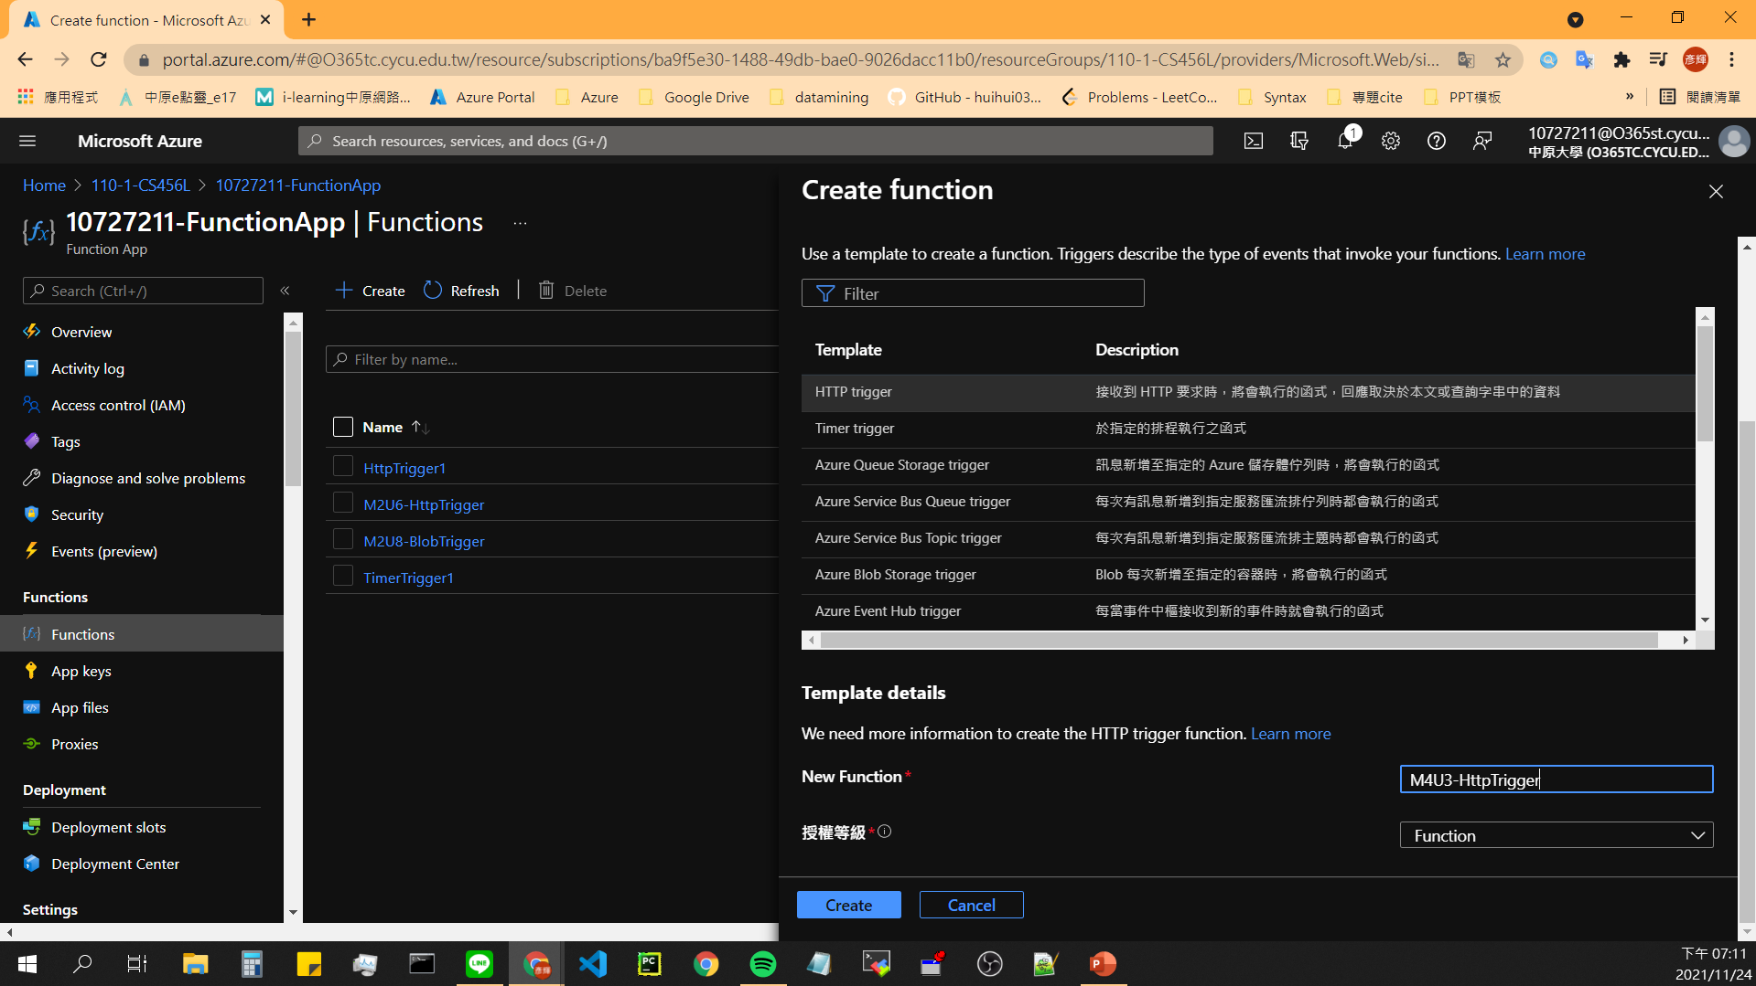
Create a http trigger function

Slide 44
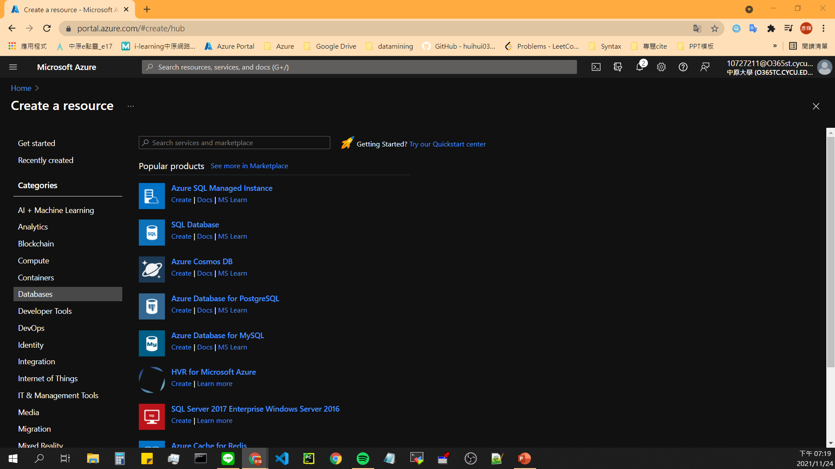
Create Azure CosmosDB - 1

Slide 45
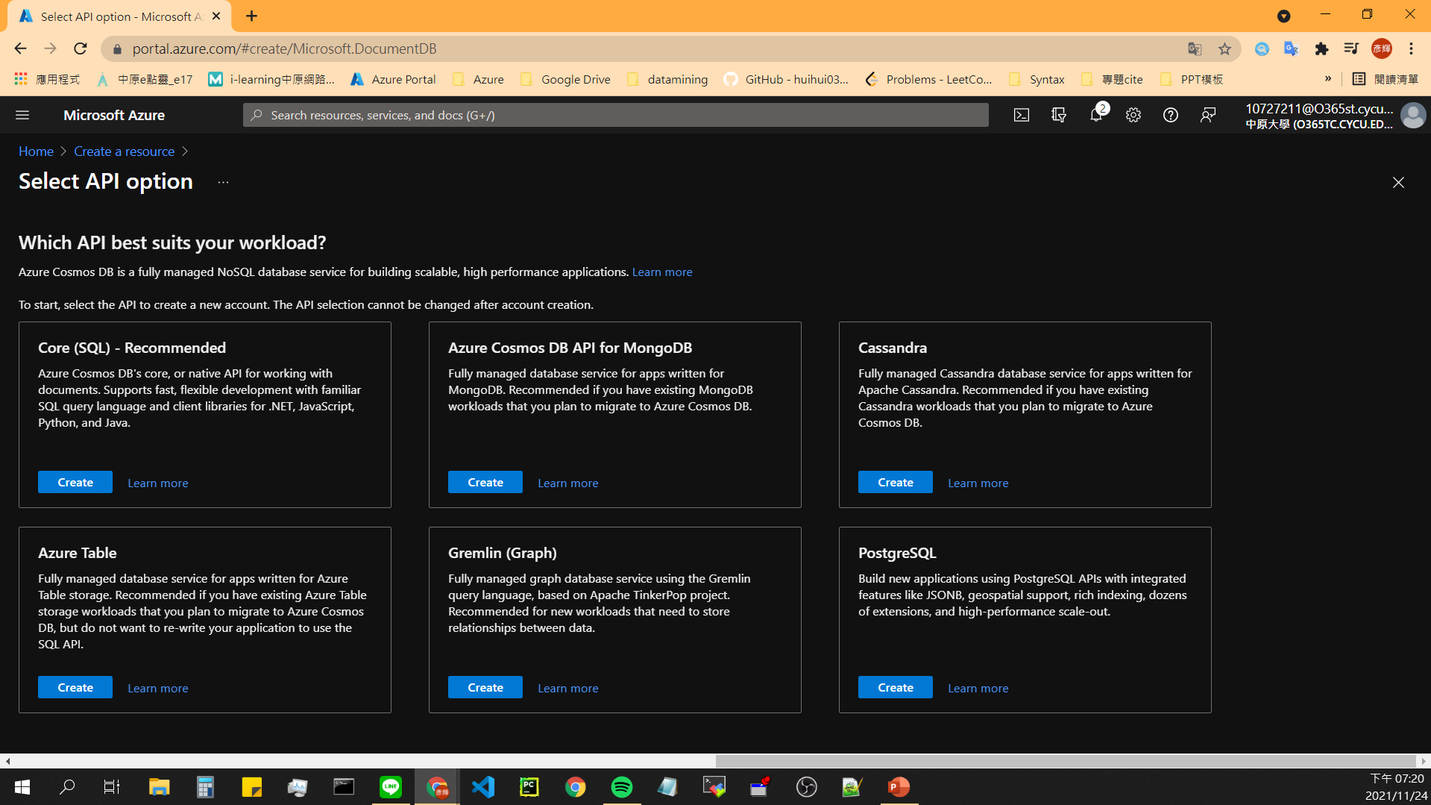
Create Azure CosmosDB - 2

Slide 46
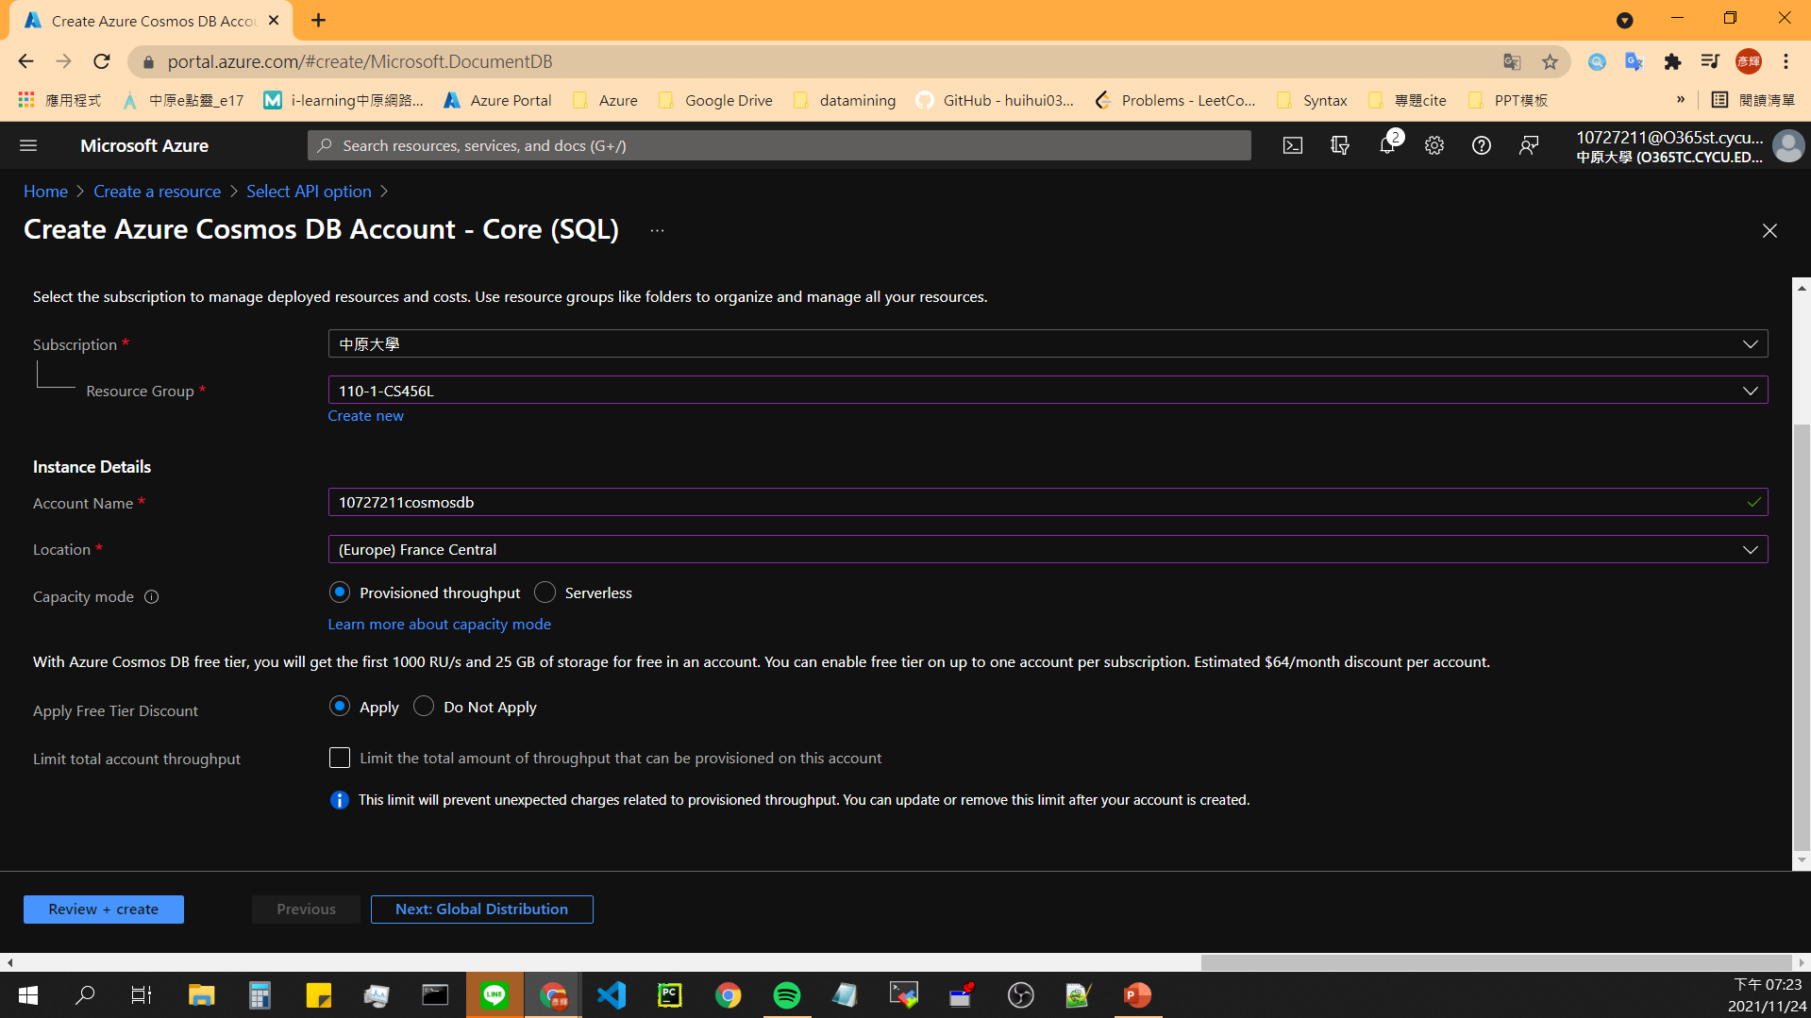
Create Azure CosmosDB - 3

Slide 47
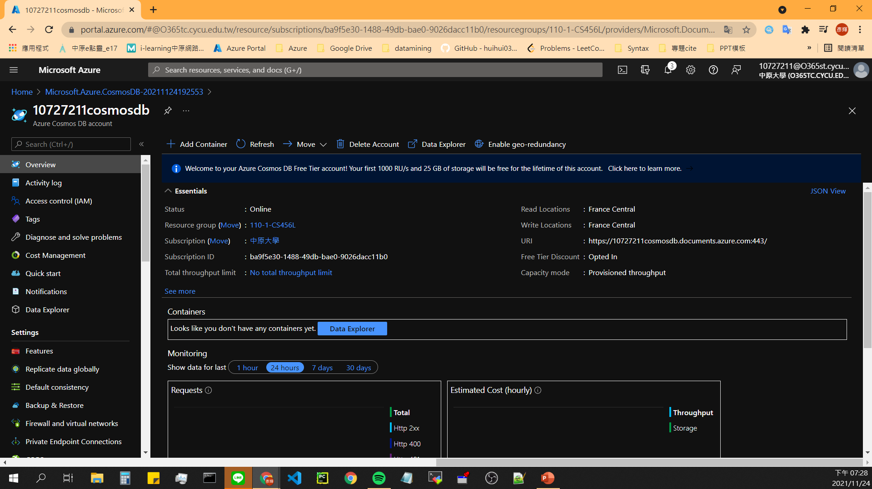
Create Azure CosmosDB - Result

Slide 48
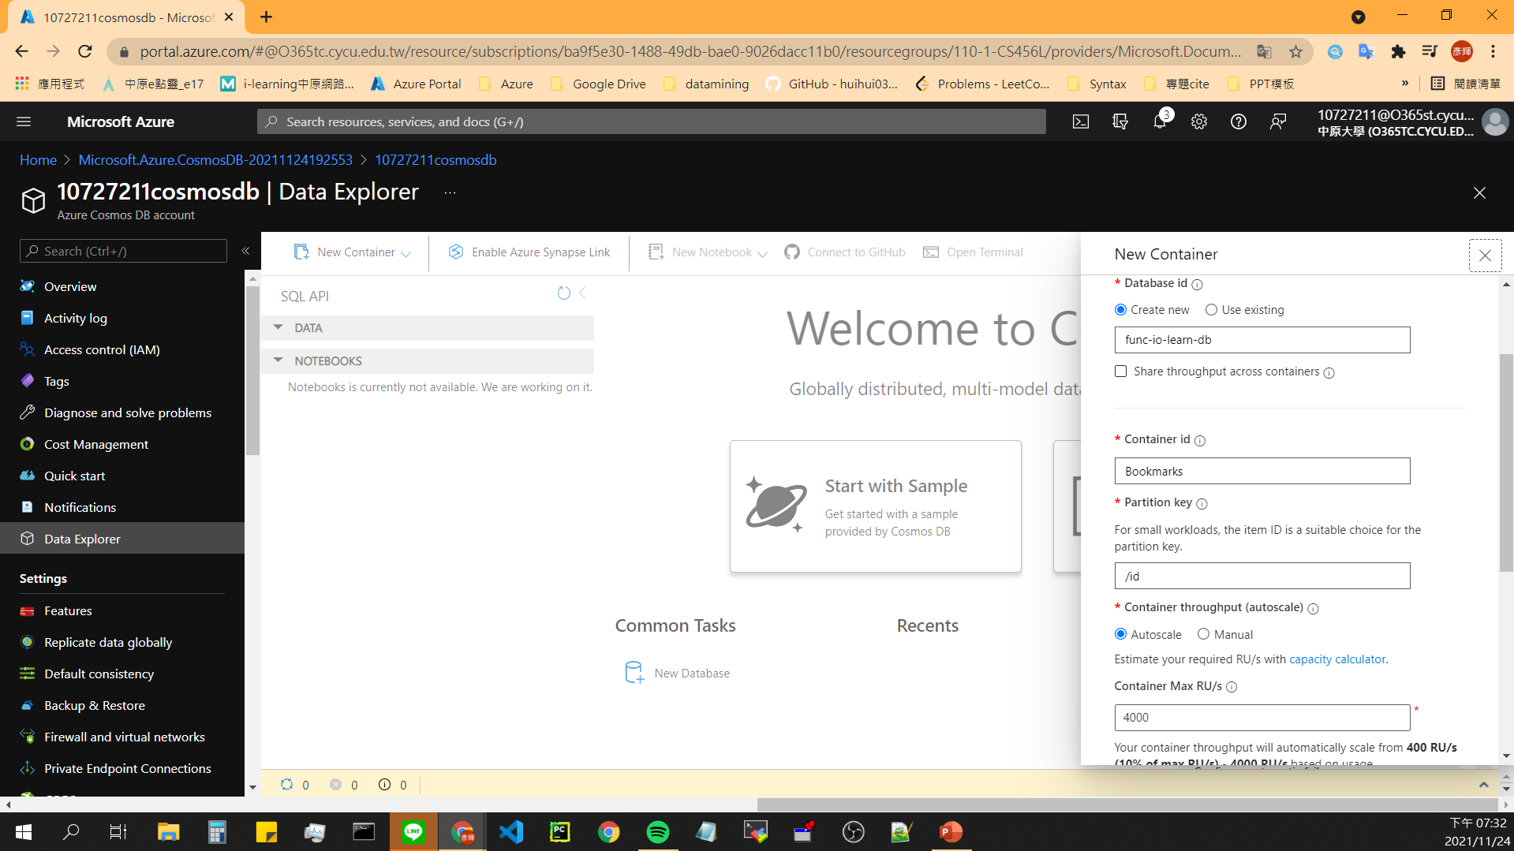
Add a Container

Slide 49
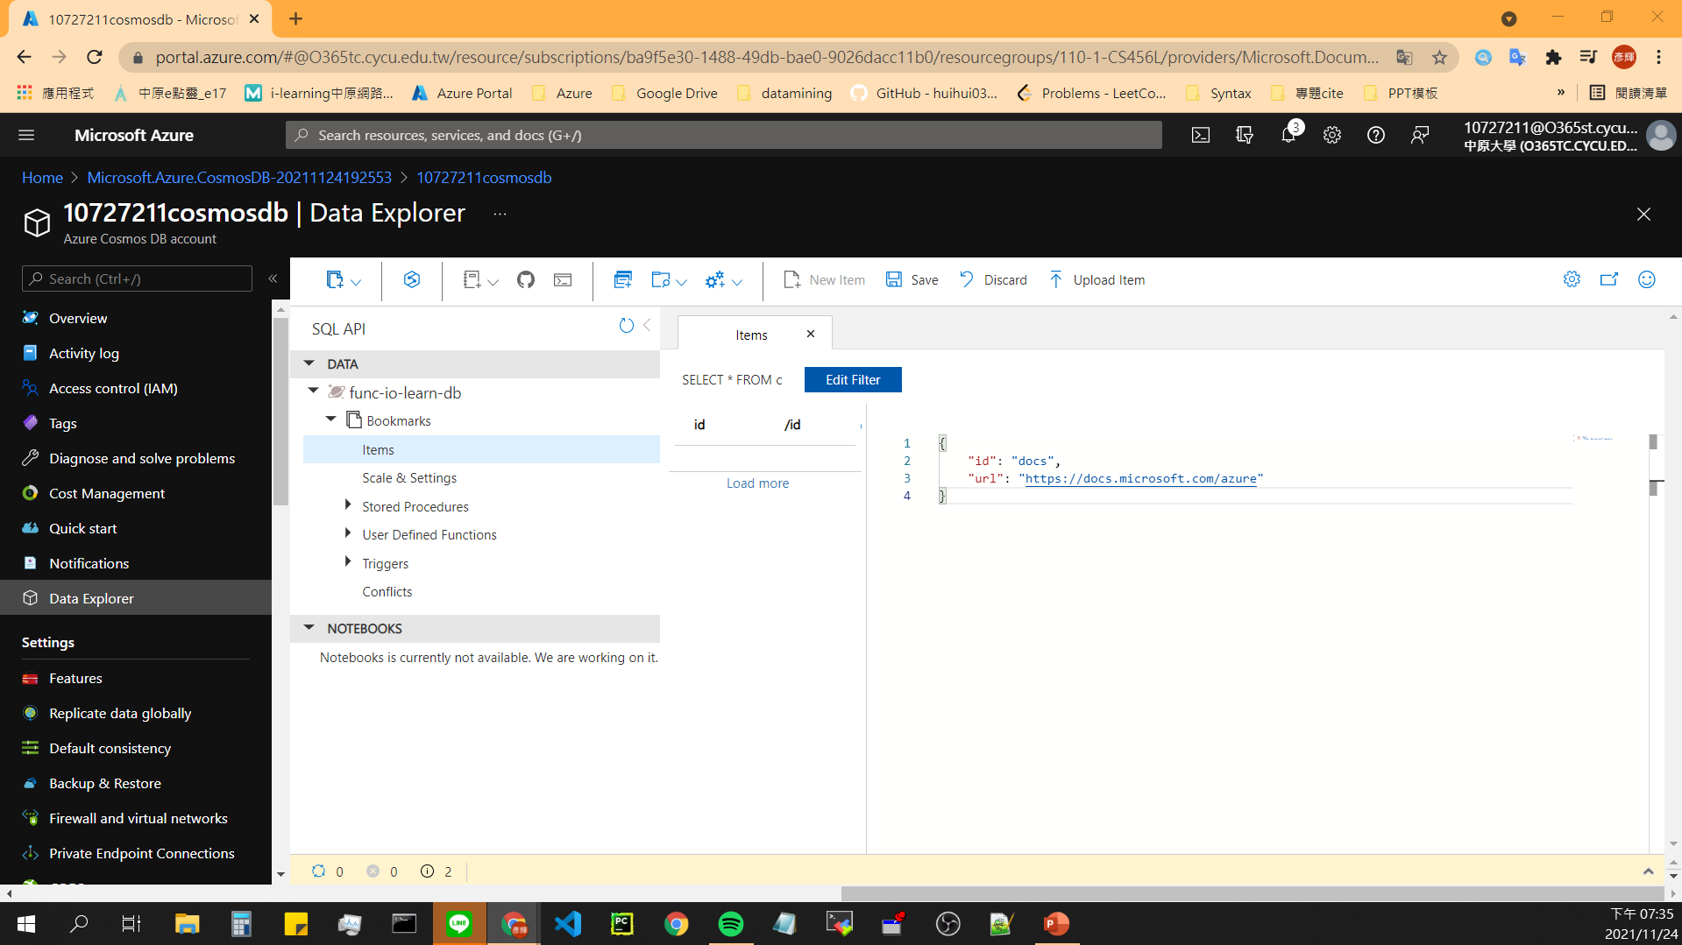
Add test data - 1
{
"id": "docs",
"url": "https://docs.microsoft.com/azure"
}
Notes:
{
"id": "docs",
"url": "https://docs.microsoft.com/azure"
}

Slide 50
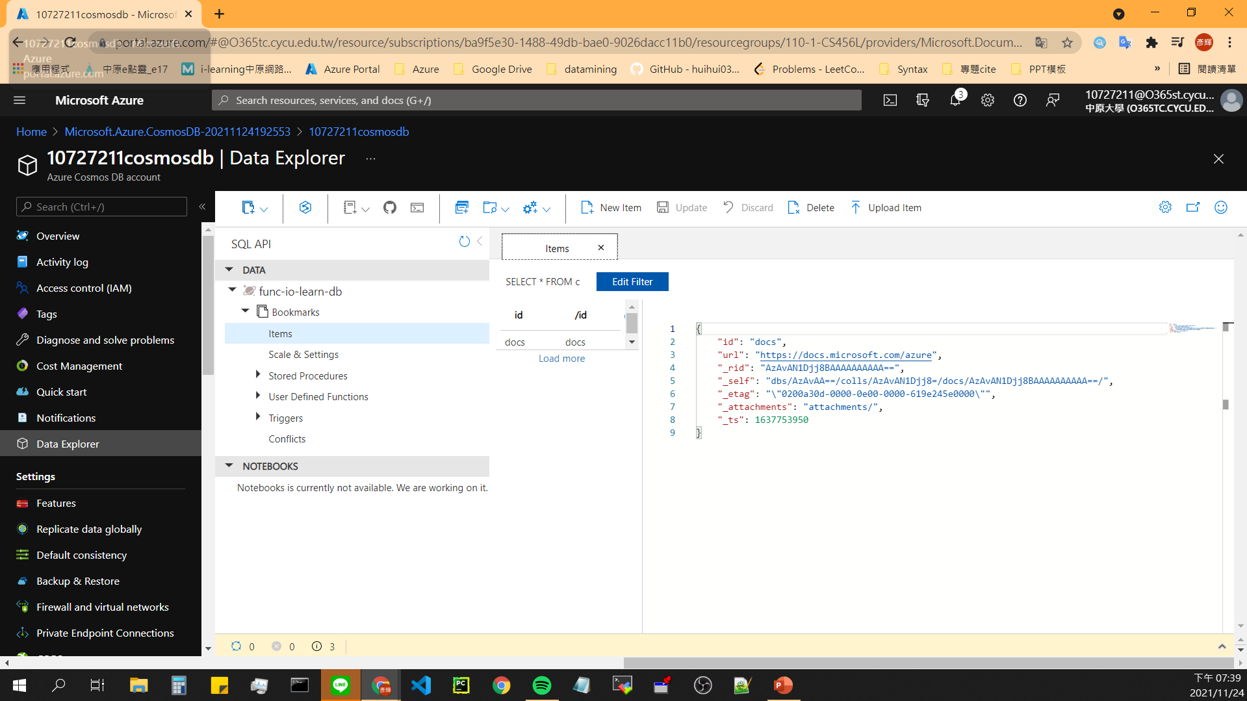
Add test data - 2

Slide 51
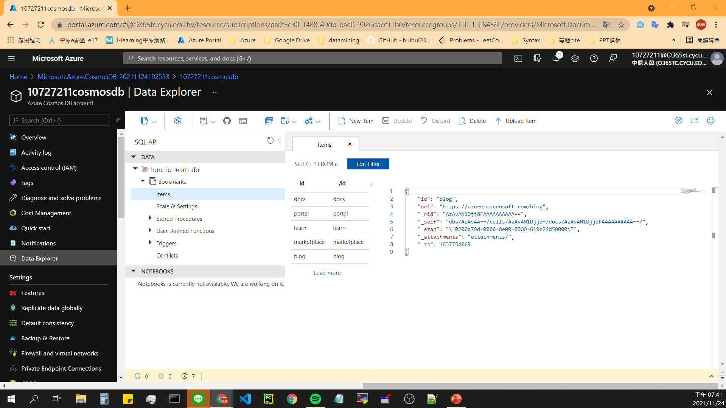
Add test data - 3
{
"id": "portal",
"url": "https://portal.azure.com"
}
{
"id": "learn",
"url": "https://docs.microsoft.com/learn"
}
{
"id": "marketplace",
"url": "https://azuremarketplace.microsoft.com/marketplace/apps"
}
{
"id": "blog",
"url": "https://azure.microsoft.com/blog"
}

Slide 52
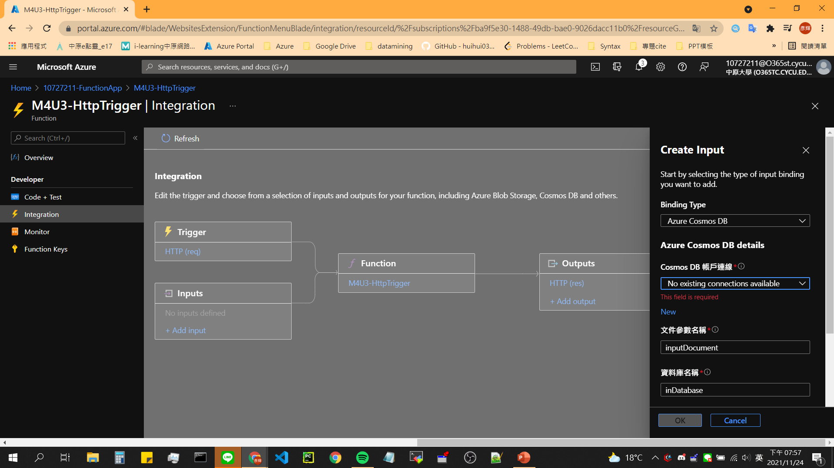
Add an Azure Cosmos DB input binding -1

Slide 53
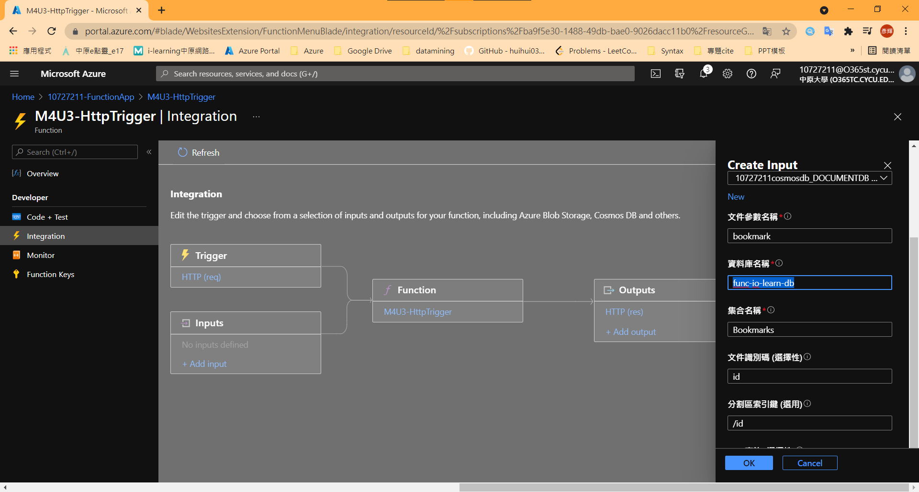
Add an Azure Cosmos DB input binding -2

Slide 54
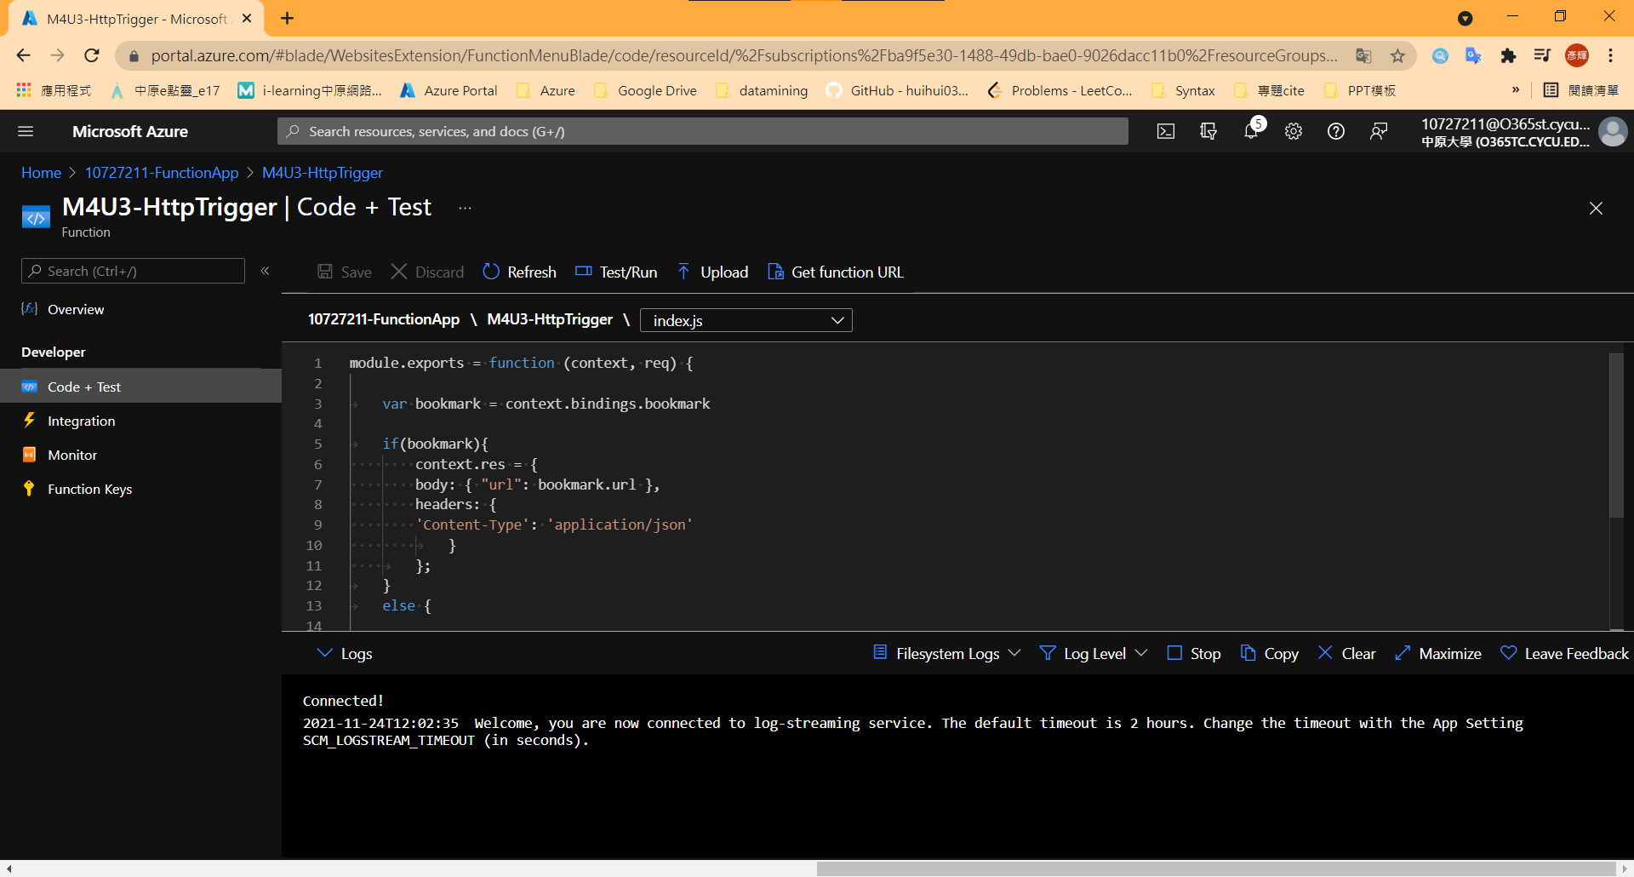
Replace index.js
Notes:
module.exports = function (context, req) {
var bookmark = context.bindings.bookmark
if(bookmark){
context.res = {
body: { "url": bookmark.url },
headers: {
'Content-Type': 'application/json'
}
};
}
else {
context.res = {
status: 404,
body : "No bookmarks found",
headers: {
'Content-Type': 'application/json'
}
};
}
context.done();
};

Slide 55
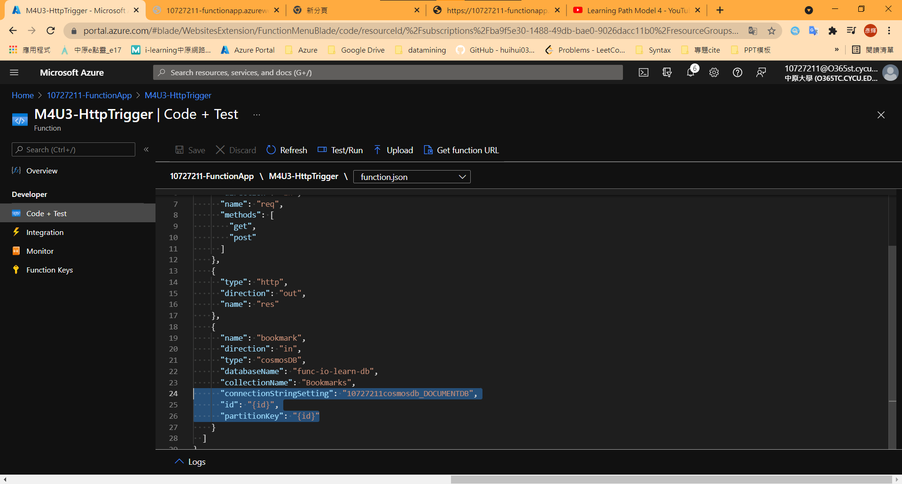
Replace function.json

Slide 56
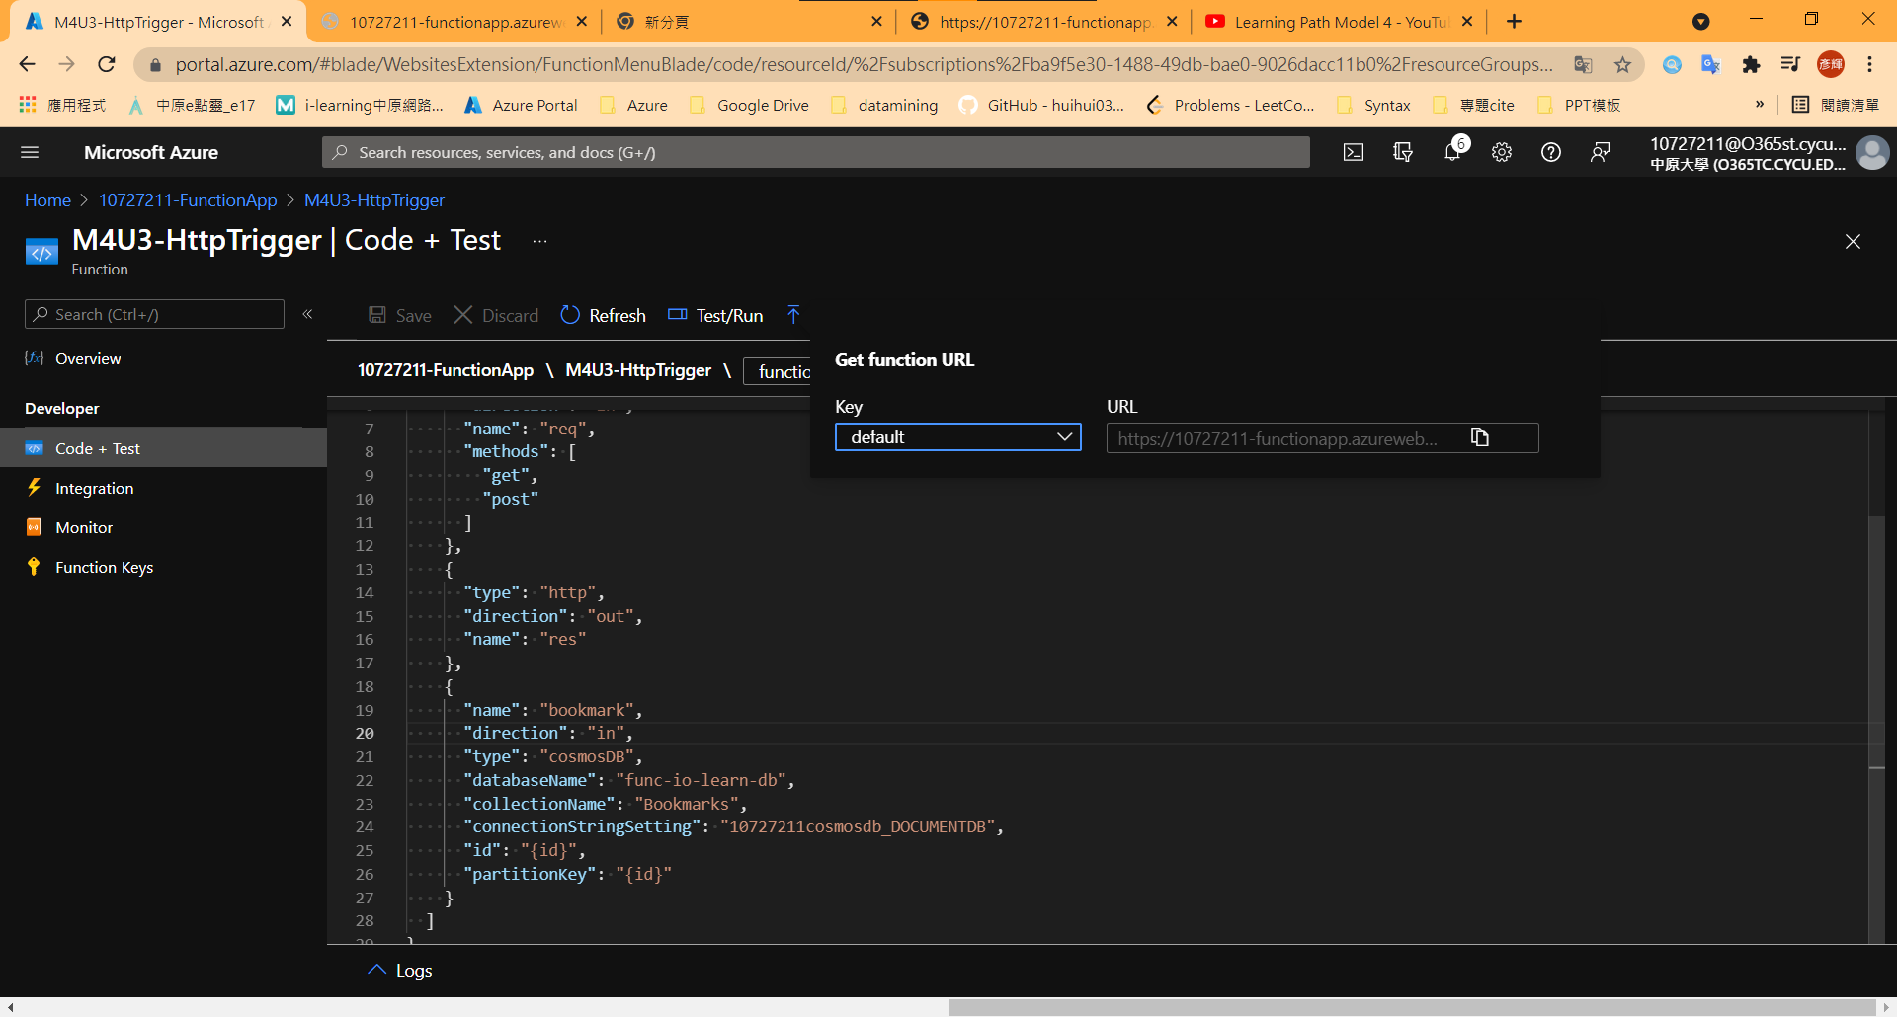
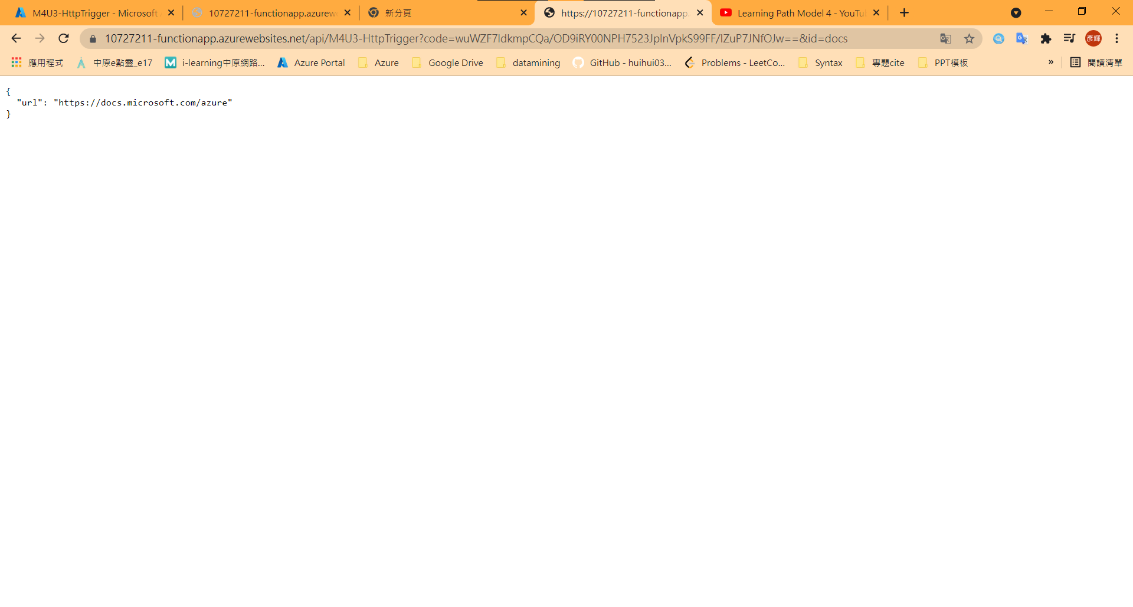
Result
Notes:
截圖!

Slide 57
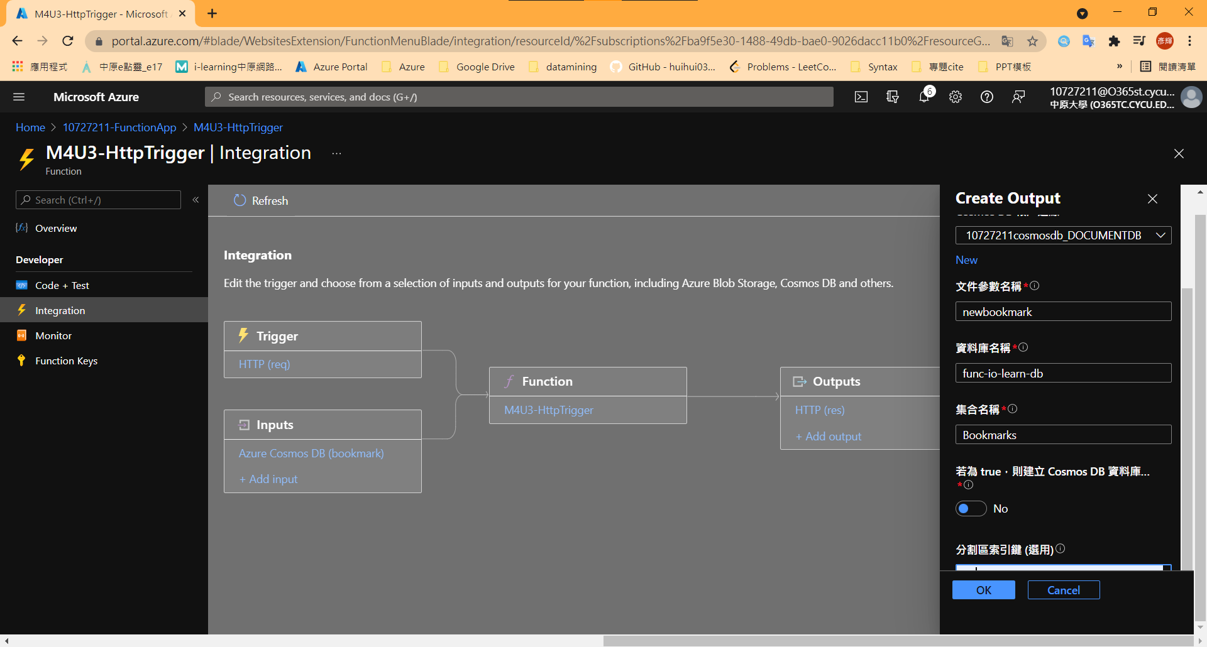
Result
/id

Slide 58

Add an Azure Queue Storage output binding

Slide 59

Replace index.js
Notes:
module.exports = function (context, req) {
var bookmark = context.bindings.bookmark
if(bookmark){
context.res = {
status: 422,
body : "Bookmark already exists.",
headers: {
'Content-Type': 'application/json'
}
};
}
else {
// Create a JSON string of our bookmark.
var bookmarkString = JSON.stringify({
id: req.body.id,
url: req.body.url
});
// Write this bookmark to our database.
context.bindings.newbookmark = bookmarkString;
// Push this bookmark onto our queue for further processing.
context.bindings.newmessage = bookmarkString;
// Tell the user all is well.
context.res = {
status: 200,
body : "bookmark added!",
headers: {
'Content-Type': 'application/json'
}
};
}
context.done();
};

Slide 60

Writing message to queue - 1
Notes:
{
"id": "github",
"url": "https://www.github.com"
}

Slide 61

Writing message to queue - 2
Notes:
截圖!

Slide 62

Verify that a message is written to the queue - 1

Slide 63

Verify that a message is written to the queue - 2
Notes:
截圖!

Slide 64
05
Create a long-running serverless workflow with Durable Functions

Slide 65

Abstract

Slide 66

Install the durable-functions npm package - 1

Slide 67

Install the durable-functions npm package - 2

Slide 68

Install the durable-functions npm package - 3
Ctrl + S
Ctrl + Q
Notes:
{
"name": "example",
"version": "1.0.0"
}

Slide 69

Install the durable-functions npm package – 4
Notes:
npm install durable-functions

Slide 70

Create Durable Functions Http start

Slide 71

Create the orchestrator function - 1
Notes:
Durable Functions orchestrator

Slide 72

Create the orchestrator function - 2
Notes:
const df = require("durable-functions");
module.exports = df.orchestrator(function* (context) {
const outputs = [];
/*
* We will call the approval activity with a reject and an approved to simulate both
*/
outputs.push(yield context.df.callActivity(“M5-Approval", "Approved"));
outputs.push(yield context.df.callActivity(“M5-Approval", "Rejected"));
return outputs;
});

Slide 73

Create the activity function - 1

Slide 74

Create the activity function - 2
Notes:
module.exports = async function (context) {
return `Your project design proposal has been - ${context.bindings.name}!`;
};

Slide 75

Check Point : HttpStart、OrchFunction、Approval

Slide 76

Verify that the durable functions workflow starts - 1
https://10727211-functionapp.azurewebsites.net/api/orchestrators/{functionName}?code=V8rtg4RJCFkOZ5cjr7wqc2g690LqUTGWWRd8s3aYAcJlgVEiKHEfnQ==
https://10727211-functionapp.azurewebsites.net/api/orchestrators/M5-OrchFunction?code=V8rtg4RJCFkOZ5cjr7wqc2g690LqUTGWWRd8s3aYAcJlgVEiKHEfnQ==

Slide 77

Verify that the durable functions workflow starts - 2

Slide 78

Verify that the durable functions workflow starts - 3
Notes:
截圖!

Slide 79

Add moment npm package to your function app
Notes:
npm install typescript
npm install moment

Slide 80

Add an escalation activity to your function app - 1

Slide 81

Add an escalation activity to your function app - 2
Notes:
module.exports = async function (context) {
return `ESCALATION : You have not approved the project design proposal - reassigning to your Manager! ${context.bindings.name}!`;
};

Slide 82

Update the orchestration function to use the escalation function
Notes:
const df = require("durable-functions");
const moment = require("moment");
module.exports = df.orchestrator(function* (context) {
const outputs = [];
const deadline = moment.utc(context.df.currentUtcDateTime).add(20, "s");
const activityTask = context.df.waitForExternalEvent("M5-Approval");
const timeoutTask = context.df.createTimer(deadline.toDate());
const winner = yield context.df.Task.any([activityTask, timeoutTask]);
if (winner === activityTask) {
outputs.push(yield context.df.callActivity("M5-Approval", "Approved"));
}
else
{
outputs.push(yield context.df.callActivity("M5-Escalation", "Head of department"));
}
if (!timeoutTask.isCompleted) {
// All pending timers must be complete or canceled before the function exits.
timeoutTask.cancel();
}
return outputs;
});

Slide 83
Verify that the Durable Functions workflow starts - 1
https://10727211-functionapp.azurewebsites.net/api/orchestrators/{functionName}?code=V8rtg4RJCFkOZ5cjr7wqc2g690LqUTGWWRd8s3aYAcJlgVEiKHEfnQ==
https://10727211-functionapp.azurewebsites.net/api/orchestrators/M5-OrchFunction?code=V8rtg4RJCFkOZ5cjr7wqc2g690LqUTGWWRd8s3aYAcJlgVEiKHEfnQ==

Slide 84

Verify that the Durable Functions workflow starts - 2

Slide 85


Verify that the Durable Functions workflow starts - 3
20s
Notes:
截圖!

Slide 86
06
Develop, test, and publish Azure Functions by using Azure Functions Core Tools

Slide 87
Starter
Warning : Azure Cloud Shell 無法實現功能 ， 請開啟Sandbox
網址：https://docs.microsoft.com/en-us/learn/modules/develop-test-deploy-azure-functions-with-core-tools/3-exercise-create-function-core-tools
Notes:
https://docs.microsoft.com/en-us/learn/modules/develop-test-deploy-azure-functions-with-core-tools/3-exercise-create-function-core-tools

Slide 88

Abstract

Slide 89

Create a local Azure Functions project

Slide 90

Create an HTTP-triggered function

Slide 91

Replace index.js
Ctrl+S
Ctrl+Q
Notes:
module.exports = async function(context, req) {
// Try to grab principal, rate, and term from the query string and
// parse them as numbers
const principal = parseFloat(req.query.principal);
const rate = parseFloat(req.query.rate);
const term = parseFloat(req.query.term);
if ([principal, rate, term].some(isNaN)) {
// If any empty or non-numeric values, return a 400 response with an
// error message
context.res = {
status: 400,
body: "Please supply principal, rate and term in the query string"
};
} else {
// Otherwise set the response body to the product of the three values
context.res = { body: principal * rate * term };
}
};

Slide 92

Run the function locally - 1

Slide 93

Run the function locally - 2

Slide 94

Output.txt

Slide 95


Create a function app
Notes:
RESOURCEGROUP="learn-2e98a7f7-7f79-4807-8b7b-7ab6fe856b96"
STORAGEACCT=learnstorage$(openssl rand -hex 5)
FUNCTIONAPP=learnfunctions$(openssl rand -hex 5)
az storage account create \
--resource-group "$RESOURCEGROUP" \
--name "$STORAGEACCT" \
--kind StorageV2 \
--location centralus
az functionapp create \
--resource-group "$RESOURCEGROUP" \
--name "$FUNCTIONAPP" \
--storage-account "$STORAGEACCT" \
--runtime node \
--consumption-plan-location centralus \
--functions-version 3

Slide 96

Publish to Azure

Slide 97

Run the function
Notes:
Add &principal=5000&rate=.035&term=36 to the end of the URL

Slide 98
07
Develop, test, and deploy an Azure Function with Visual Studio

Slide 99

Abstract

Slide 100
Starter - Requirement
Install Visual Studio & package

Slide 101

Open Visual Studio Installer - 1

Slide 102

Open Visual Studio Installer - 2
在此步驟下載相關套件

Slide 103
Create an Azure Function App - 1

Slide 104

Create an Azure Function App - 2

Slide 105

Create an Azure Function App - 3

Slide 106

Create an Azure Function App - 4

Slide 107

Create an Azure Function App - 5

Slide 108

Create the WatchInfo Azure Function - 1
Notes:
WatchPortalFunction > Add > New Azure Function…

Slide 109

Create the WatchInfo Azure Function - 2

Slide 110

Create the WatchInfo Azure Function - 3

Slide 111

Create the WatchInfo Azure Function - 4
Notes:
using System;
using System.IO;
using System.Threading.Tasks;
using Microsoft.AspNetCore.Mvc;
using Microsoft.Azure.WebJobs;
using Microsoft.Azure.WebJobs.Extensions.Http;
using Microsoft.AspNetCore.Http;
using Microsoft.Extensions.Logging;
using Newtonsoft.Json;
namespace WatchPortalFunction
{
public static class WatchInfo
{
[FunctionName("WatchInfo")]
public static async Task<IActionResult> Run(
[HttpTrigger(AuthorizationLevel.Anonymous, "get", "post", Route = null)] HttpRequest req,
ILogger log)
{
log.LogInformation("C# HTTP trigger function processed a request.");
// Retrieve the model id from the query string
string model = req.Query["model"];
// If the user specified a model id, find the details of the model of watch
if (model != null)
{
// Use dummy data for this example
dynamic watchinfo = new { Manufacturer = "abc", CaseType = "Solid", Bezel = "Titanium", Dial = "Roman", CaseFinish = "Silver", Jewels = 15 };
return (ActionResult)new OkObjectResult($"Watch Details: {watchinfo.Manufacturer}, {watchinfo.CaseType}, {watchinfo.Bezel}, {watchinfo.Dial}, {watchinfo.CaseFinish}, {watchinfo.Jewels}");
}
return new BadRequestObjectResult("Please provide a watch model in the query string");
}
}
}

Slide 112

Test the Azure Function locally - 1
Notes:
Debug > Start Debugging

Slide 113

Test the Azure Function locally - 2
Notes:
截圖!

Slide 114

Test the Azure Function locally - 3
Notes:
Stop Debug
Breakpoint > Insert Breakpoint

Slide 115

Test the Azure Function locally - 4
Notes:
Debug > Start Debug

Slide 116

Test the Azure Function locally - 5
在Browser http://localhost:7071/api/WatchInfo?model=abc F5重新整理一次
Notes:
截圖!

Slide 117

Test the Azure Function locally - 6

Slide 118

Test the Azure Function locally - 7

Slide 119

Test the Azure Function locally - 8

Slide 120

Test the Azure Function locally - 9

Slide 121

Deploy the WatchInfo function to the Azure Function App - 1
Notes:
WatchPortalFunction > Publish..

Slide 122

Deploy the WatchInfo function to the Azure Function App - 2

Slide 123

Deploy the WatchInfo function to the Azure Function App - 3

Slide 124

Deploy the WatchInfo function to the Azure Function App - 4

Slide 125

Deploy the WatchInfo function to the Azure Function App - 5

Slide 126


Deploy the WatchInfo function to the Azure Function App – 6

Slide 127


Verify the functions have been deployed
Notes:
截圖!

Slide 128

Unit test an Azure Function - 1
Notes:
Solution “WatchPortalFunction’ > Add > New Project…

Slide 129

Unit test an Azure Function - 2

Slide 130

Unit test an Azure Function - 3

Slide 131

Unit test an Azure Function - 4

Slide 132

Unit test an Azure Function - 5
Notes:
WatchFunctionsTests > Manage NuGet Packages…

Slide 133

Unit test an Azure Function - 6

Slide 134


Unit test an Azure Function - 7

Slide 135

Unit test an Azure Function - 8
Notes:
UnitTest1.cs > Rename
WatchFunctionUnitTests

Slide 136


Unit test an Azure Function - 9
Notes:
WatchFunctionUnitTests

Slide 137

Unit test an Azure Function - 10
Notes:
Dependencies > Add Project Reference…

Slide 138

Unit test an Azure Function - 11

Slide 139

Unit test an Azure Function - 12
Notes:
using System;
using Xunit;
using Microsoft.AspNetCore.Http;
using Microsoft.AspNetCore.Http.Internal;
using Microsoft.AspNetCore.Mvc;
using Microsoft.Extensions.Primitives;
using Microsoft.Extensions.Logging.Abstractions;
namespace WatchFunctionsTests
{
public class WatchFunctionUnitTests
{
[Fact]
public void TestWatchFunctionSuccess()
{
var queryStringValue = "abc";
var request = new DefaultHttpRequest(new DefaultHttpContext())
{
Query = new QueryCollection
(
new System.Collections.Generic.Dictionary<string, StringValues>()
{
{ "model", queryStringValue }
}
)
};
var logger = NullLoggerFactory.Instance.CreateLogger("Null Logger");
var response = WatchPortalFunction.WatchInfo.Run(request, logger);
response.Wait();
// Check that the response is an "OK" response
Assert.IsAssignableFrom<OkObjectResult>(response.Result);
// Check that the contents of the response are the expected contents
var result = (OkObjectResult)response.Result;
dynamic watchinfo = new { Manufacturer = "abc", CaseType = "Solid", Bezel = "Titanium", Dial = "Roman", CaseFinish = "Silver", Jewels = 15 };
string watchInfo = $"Watch Details: {watchinfo.Manufacturer}, {watchinfo.CaseType}, {watchinfo.Bezel}, {watchinfo.Dial}, {watchinfo.CaseFinish}, {watchinfo.Jewels}";
Assert.Equal(watchInfo, result.Value);
}
[Fact]
public void TestWatchFunctionFailureNoQueryString()
{
var request = new DefaultHttpRequest(new DefaultHttpContext());
var logger = NullLoggerFactory.Instance.CreateLogger("Null Logger");
var response = WatchPortalFunction.WatchInfo.Run(request, logger);
response.Wait();
// Check that the response is an "Bad" response
Assert.IsAssignableFrom<BadRequestObjectResult>(response.Result);
// Check that the contents of the response are the expected contents
var result = (BadRequestObjectResult)response.Result;
Assert.Equal("Please provide a watch model in the query string", result.Value);
}
[Fact]
public void TestWatchFunctionFailureNoModel()
{
var queryStringValue = "abc";
var request = new DefaultHttpRequest(new DefaultHttpContext())
{
Query = new QueryCollection
(
new System.Collections.Generic.Dictionary<string, StringValues>()
{
{ "not-model", queryStringValue }
}
)
};
var logger = NullLoggerFactory.Instance.CreateLogger("Null Logger");
var response = WatchPortalFunction.WatchInfo.Run(request, logger);
response.Wait();
// Check that the response is an "Bad" response
Assert.IsAssignableFrom<BadRequestObjectResult>(response.Result);
// Check that the contents of the response are the expected contents
var result = (BadRequestObjectResult)response.Result;
Assert.Equal("Please provide a watch model in the query string", result.Value);
}
}
}

Slide 140

Unit test an Azure Function - 13
Notes:
Test > Run All Tests

Slide 141

Unit test an Azure Function - 14
Notes:
截圖!

Slide 142

Unit test an Azure Function - 15
名字隨意，單純測Error用

Slide 143
Unit test an Azure Function - 16
Notes:
Test > Run All Tests

Slide 144

Unit test an Azure Function - 17
Notes:
截圖!

Slide 145
Resource Check
Remove Resource
- cosmosdb
- functionapp

Slide 146
08
Monitor GitHub events by using a webhook with Azure Functions

Slide 147

Abstract

Slide 148

Create a webhook triggered function

Slide 149

Set up a webhook for a GitHub repository - 1
Notes:
Github.com

Slide 150

Set up a webhook for a GitHub repository - 2

Slide 151

Add a webhook for the Gollum event - 1

Slide 152

Add a webhook for the Gollum event - 2

Slide 153

Add a webhook for the Gollum event - 3

Slide 154

Add a webhook for the Gollum event - 4

Slide 155

Add a webhook for the Gollum event - 5

Slide 156

Add a webhook for the Gollum event - 6
只選Wiki 其他不勾

Slide 157

Test the webhook - 1

Slide 158

Test the webhook - 2

Slide 159

Test the webhook - 3

Slide 160

Test the webhook - 4

Slide 161


Test the webhook - 5

Slide 162

Exercise - Trigger an Azure Function with a GitHub event - 1
Notes:
module.exports = async function (context, req) {
context.log('JavaScript HTTP trigger function processed a request.');
const name = (req.query.name || (req.body && req.body.name));
const responseMessage = name
? "Hello, " + name + ". This HTTP triggered function executed successfully."
: "This HTTP triggered function executed successfully. Pass a name in the query string or in the request body for a personalized response.";
if (req.body.pages[0].title){
context.res = {
body: "Page is " + req.body.pages[0].title + ", Action is " + req.body.pages[0].action + ", Event Type is " + req.headers['x-github-event']
};
}
else {
context.res = {
status: 400,
body: ("Invalid payload for Wiki event")
};
}
}

Slide 163
Exercise - Trigger an Azure Function with a GitHub event - 2

Slide 164

Exercise - Trigger an Azure Function with a GitHub event - 3

Slide 165

Exercise - Trigger an Azure Function with a GitHub event - 4

Slide 166

Get a key for your Azure Function
Notes:
const Crypto = require('crypto');
module.exports = async function (context, req) {
context.log('JavaScript HTTP trigger function processed a request.');
const hmac = Crypto.createHmac("sha1", "<default key>");
const signature = hmac.update(JSON.stringify(req.body)).digest('hex');
const shaSignature = `sha1=${signature}`;
const gitHubSignature = req.headers['x-hub-signature'];
if (!shaSignature.localeCompare(gitHubSignature)) {
if (req.body.pages[0].title) {
context.res = {
body: "Page is " + req.body.pages[0].title + ", Action is " + req.body.pages[0].action + ", Event Type is " + req.headers['x-github-event']
};
}
else {
context.res = {
status: 400,
body: ("Invalid payload for Wiki event")
}
}
}
else {
context.res = {
status: 401,
body: "Signatures don't match"
};
}
};

Slide 167

Update the webhook secret - 1

Slide 168

Update the webhook secret - 2

Slide 169

Test the webhook and the Azure Function - 1
Update Webhook

Slide 170

Test the webhook and the Azure Function - 2

Slide 171

Test the webhook and the Azure Function - 3

Slide 172


Test the webhook and the Azure Function - 4
Notes:
截圖!

Slide 173

Test an invalid signature - 1
隨便輸入一串字
Update webhook

Slide 174


Test an invalid signature - 2
Notes:
截圖!

Slide 175
09
Enable automatic updates in a web application using Azure Functions and SignalR Service

Slide 176

Abstract

Slide 177

Create a Storage account and Azure Cosmos DB account - 1

Slide 178
Create a Storage account and Azure Cosmos DB account - 2
export STORAGE_ACCOUNT_NAME=10727211model9storage
echo "Storage Account Name: $STORAGE_ACCOUNT_NAME"
az storage account create \
--name $STORAGE_ACCOUNT_NAME \
--resource-group 110-1-CS456L \
--kind StorageV2 \
--sku Standard_LRS
az cosmosdb create \
--name 10727211cosmosdb \
--resource-group 110-1-CS456L

Slide 179

Download sample app code & switch directory
Notes:
git clone https://github.com/MicrosoftDocs/mslearn-advocates.azure-functions-and-signalr.git serverless-demo
code .\serverless-demo\start\

Slide 180

Check path

Slide 181
Update local settings - 1

Slide 182
Update local settings - 2
STORAGE_CONNECTION_STRING=$(az storage account show-connection-string \
--name $(az storage account list \
--resource-group 110-1-CS456L \
--query [0].name -o tsv) \
--resource-group 110-1-CS456L \
--query "connectionString" -o tsv)
COSMOSDB_ACCOUNT_NAME=$(az cosmosdb list \
--resource-group 110-1-CS456L \
--query [0].name -o tsv)
COSMOSDB_CONNECTION_STRING=$(az cosmosdb list-connection-strings \
--name $COSMOSDB_ACCOUNT_NAME \
--resource-group 110-1-CS456L \
--query "connectionStrings[?description=='Primary SQL Connection String'].connectionString" -o tsv)
COSMOSDB_MASTER_KEY=$(az cosmosdb list-keys \
--name $COSMOSDB_ACCOUNT_NAME \
--resource-group 110-1-CS456L \
--query primaryMasterKey -o tsv)
printf "\n\nReplace <STORAGE_CONNECTION_STRING> with:\n$STORAGE_CONNECTION_STRING\n\nReplace <COSMOSDB_CONNECTION_STRING> with:\n$COSMOSDB_CONNECTION_STRING\n\nReplace <COSMOSDB_MASTER_KEY> with:\n$COSMOSDB_MASTER_KEY\n\n"

Slide 183

Update local settings - 3

Slide 184

Update local settings - 4

Slide 185

Run the application - 1
Notes:
npm install

Slide 186

Run the application - 2
Notes:
F5

Slide 187

Run the application - 3
Notes:
截圖!

Slide 188

Run the application - 4
Notes:
Npm run update-data

Slide 189


Run the application - 5

Slide 190
Create a SignalR account - 1

Slide 191
Create a SignalR account - 2
SIGNALR_SERVICE_NAME=s10727211signalr
az signalr create \
--name $SIGNALR_SERVICE_NAME \
--resource-group 110-1-CS456L \
--sku Free_DS2 \
--unit-count 1
az resource update \
--resource-type Microsoft.SignalRService/SignalR \
--name $SIGNALR_SERVICE_NAME \
--resource-group 110-1-CS456L \
--set properties.features[flag=ServiceMode].value=Serverless
SIGNALR_CONNECTION_STRING=$(az signalr key list \
--name $(az signalr list \
--resource-group 110-1-CS456L \
--query [0].name -o tsv) \
--resource-group 110-1-CS456L \
--query primaryConnectionString -o tsv)
printf "\n\nReplace <SIGNALR_CONNECTION_STRING> with:\n$SIGNALR_CONNECTION_STRING\n\n"

Slide 192

Update local settings - 1

Slide 193

Update local settings - 2

Slide 194

Manage client connections- 1
Notes:
F1

Slide 195
Manage client connections- 2
 | Azure Functions: Create Function
Template | HTTP Trigger
Name | negotiate
Authorization level | Anonymous

Slide 196

Manage client connections- 3
Notes:
{
"bindings": [
{
"authLevel": "anonymous",
"type": "httpTrigger",
"direction": "in",
"name": "req",
"methods": [
"get",
"post"
]
},
{
"type": "http",
"direction": "out",
"name": "res"
},
{
"type": "signalRConnectionInfo",
"name": "connectionInfo",
"hubName": "stocks",
"direction": "in",
"connectionStringSetting": "AzureSignalRConnectionString"
}
]
}

Slide 197

Manage client connections- 4
Notes:
module.exports = async function (context, req, connectionInfo) {
context.res.body = connectionInfo;
};

Slide 198
Detect and broadcast database changes - 1
 | Azure Functions: Create Function
Template | Azure Cosmos DB Trigger
Name | stocksChanged
App setting for your Azure Cosmos DB account | AzureCosmosDBConnectionString
Database name | stocksdb
Collection name | stocks
Collection name for leases | leases
Create lease collection if not exists | true

Slide 199

Detect and broadcast database changes - 2
Notes:
{
"bindings": [
{
"type": "cosmosDBTrigger",
"name": "documents",
"direction": "in",
"leaseCollectionName": "leases",
"connectionStringSetting": "AzureCosmosDBConnectionString",
"databaseName": "stocksdb",
"collectionName": "stocks",
"createLeaseCollectionIfNotExists": "true",
"feedPollDelay": 500
},
{
"type": "signalR",
"name": "signalRMessages",
"connectionString": "AzureSignalRConnectionString",
"hubName": "stocks",
"direction": "out"
}
]
}

Slide 200

Detect and broadcast database changes - 3
Notes:
module.exports = async function (context, documents) {
const updates = documents.map(stock => ({
target: 'updated',
arguments: [stock]
}));
context.bindings.signalRMessages = updates;
context.done();
}

Slide 201

Update the web application - 1
Notes:
<!DOCTYPE html>
<html lang="en">
<head>
<meta charset="UTF-8">
<meta name="viewport" content="width=device-width, initial-scale=1.0">
<meta http-equiv="X-UA-Compatible" content="ie=edge">
<link rel="stylesheet" href="https://cdnjs.cloudflare.com/ajax/libs/bulma/0.7.4/css/bulma.min.css" integrity="sha256-8B1OaG0zT7uYA572S2xOxWACq9NXYPQ+U5kHPV1bJN4=" crossorigin="anonymous" />
<link rel="stylesheet" href="https://use.fontawesome.com/releases/v5.8.1/css/all.css" integrity="sha384-50oBUHEmvpQ+1lW4y57PTFmhCaXp0ML5d60M1M7uH2+nqUivzIebhndOJK28anvf" crossorigin="anonymous">
<link rel="stylesheet" href="index.html.css">
<title>Stocks | Enable automatic updates in a web application using Azure Functions and SignalR</title>
</head>
<body>
<!-- BEGIN: Replace markup in this section -->
<div id="app" class="container">
<h1 class="title">Stocks</h1>
<div id="stocks">
<div v-for="stock in stocks" class="stock">
<transition name="fade" mode="out-in">
<div class="list-item" :key="stock.price">
<div class="lead">{{ stock.symbol }}: ${{ stock.price }}</div>
<div class="change">Change:
<span
:class="{ 'is-up': stock.changeDirection === '+', 'is-down': stock.changeDirection === '-' }">
{{ stock.changeDirection }}{{ stock.change }}
</span>
</div>
</div>
</transition>
</div>
</div>
</div>
<!-- END -->
<script src="https://cdnjs.cloudflare.com/ajax/libs/vue/2.6.10/vue.min.js" integrity="sha256-chlNFSVx3TdcQ2Xlw7SvnbLAavAQLO0Y/LBiWX04viY=" crossorigin="anonymous"></script>
<script src="https://cdnjs.cloudflare.com/ajax/libs/axios/0.19.0/axios.min.js" integrity="sha256-S1J4GVHHDMiirir9qsXWc8ZWw74PHHafpsHp5PXtjTs=" crossorigin="anonymous"></script>
<script src="https://cdn.jsdelivr.net/npm/@aspnet/signalr@1.1.0/dist/browser/signalr.js"></script>
<script src="index.html.js" type="text/javascript"></script>
</body>
</html>

Slide 202

Update the web application - 2
Notes:
const LOCAL_BASE_URL = 'http://localhost:7071';
const REMOTE_BASE_URL = '<FUNCTION_APP_ENDPOINT>';
const getAPIBaseUrl = () => {
const isLocal = /localhost/.test(window.location.href);
return isLocal ? LOCAL_BASE_URL : REMOTE_BASE_URL;
}
const app = new Vue({
el: '#app',
data() {
return {
stocks: []
}
},
methods: {
async getStocks() {
try {
const apiUrl = `${getAPIBaseUrl()}/api/getStocks`;
const response = await axios.get(apiUrl);
app.stocks = response.data;
} catch (ex) {
console.error(ex);
}
}
},
created() {
this.getStocks();
}
});
const connect = () => {
const connection = new signalR.HubConnectionBuilder()
.withUrl(`${getAPIBaseUrl()}/api`)
.build();
connection.onclose(() => {
console.log('SignalR connection disconnected');
setTimeout(() => connect(), 2000);
});
connection.on('updated', updatedStock => {
const index = app.stocks.findIndex(s => s.id === updatedStock.id);
app.stocks.splice(index, 1, updatedStock);
});
connection.start().then(() => {
console.log("SignalR connection established");
});
};
connect();

Slide 203

Run the application - 1
Notes:
F5 + npm start

Slide 204

Run the application - 2
Notes:
截圖

Slide 205
Login
F1
> Azure Sign in

Slide 206


Slide 207

Select Subscriptions

Slide 208
Deploy the function app - 1
 | Azure Functions: Deploy to Function App
Template | Create new Function App in Azure... Advanced
Name | 10727211-deployfunctionapp
Running Stack | Node.js 8 LTS
Resource Group | 110-1-CS456L
Location for new resource | 東南亞 (for CS456L)
Hosting Plan | Consumption
storage | 10727211model9storage
Application Insights resource | Skip for now

Slide 209

Deploy the function app - 2

Slide 210

Deploy the function app - 3

Slide 211

Deploy the function app - 4
 | Azure Functions: Upload local settings
Function App in Azure | 10727211-deployfunctionapp

Slide 212


Configure static websites in Azure Storage && Deploy the web application to Azure Storage
 | Azure Storage: Configure Static Website
Storage account | 10727211model9storage
Default file | Index.html
Error document | Index.html
 | Azure Storage: Deploy to static website via Azure Storage
Storage account | 10727211model9storage
Select the folder to deploy | Select browse and choose the public subfolder containing the web app.

Slide 213

Set up CORS in the function app - 1

Slide 214

Set up CORS in the function app - 2

Slide 215

Run the deployed application
Notes:
npm run update-data
截圖!

Slide 216
10
Expose multiple Azure Function apps as a consistent API by using Azure API Management

Slide 217

Abstract

Slide 218
Environment
Sandbox recommend
官方提供腳本 Create Resource時，名稱會是random (管理不易)
網址：https://docs.microsoft.com/en-us/learn/modules/build-serverless-api-with-functions-api-management/3-exercise-import-function-app-api-management

Slide 219

Create functions - 1
Notes:
git clone https://github.com/MicrosoftDocs/mslearn-apim-and-functions.git ~/OnlineStoreFuncs
cd ~/OnlineStoreFuncs
bash setup.sh

Slide 220

Test the product details function - 1

Slide 221

Test the product details function - 2

Slide 222

Test the product details function - 3

Slide 223


Test the product details function - 4

Slide 224

Expose function app as an API using Azure API Management - 1

Slide 225

Expose function app as an API using Azure API Management - 2

Slide 226

Expose function app as an API using Azure API Management - 3

Slide 227

Expose function app as an API using Azure API Management - 4

Slide 228

Expose function app as an API using Azure API Management - 5

Slide 229

Test the OnlineStore products endpoint - 1

Slide 230

Test the OnlineStore products endpoint - 2

Slide 231

Test the OrderDetails function - 1

Slide 232

Test the OrderDetails function - 2

Slide 233

Test the OrderDetails function - 3

Slide 234

Add a function to an existing API - 1

Slide 235

Add a function to an existing API - 2

Slide 236

Add a function to an existing API - 3

Slide 237

Add a function to an existing API - 4

Slide 238

Add a function to an existing API - 5

Slide 239

Add a function to an existing API - 6

Slide 240

Add a function to an existing API - 7

Slide 241

Add a function to an existing API - 8

Slide 242

Add a function to an existing API - 9

Slide 243

Test the OnlineStore orders endpoint in the portal - 1

Slide 244

Test the OnlineStore orders endpoint in the portal - 2

Slide 245

Test the combined API - 1

Slide 246

Test the combined API - 2
Notes:
GATEWAY_URL=<paste URL here>
ｅｇ：GATEWAY_URL=https://orderfunction30124ea1de-apim.azure-api.net

Slide 247

Test the combined API - 3

Slide 248

Test the combined API - 4
Notes:
SUB_KEY=<paste key here>
ｅｇ：SUB_KEY=529ac41512c54e069ae98758c75b5d84

Slide 249

Test the combined API - 5
Notes:
curl -X GET "$GATEWAY_URL/orders/OrderDetails?name=Henri" -H "Ocp-Apim-Subscription-Key:$SUB_KEY“
截圖!

Slide 250

Test the combined API - 6
切換至productfunction apim，再做一次 Test the combined API
Notes:
curl -X GET "$GATEWAY_URL/orders/OrderDetails?name=Henri" -H "Ocp-Apim-Subscription-Key:$SUB_KEY“
截圖!

Slide 251
11
Build serverless apps with Go

Slide 252

Abstract

Slide 253

Starter
Env : Visual Studio Code
/Go-Demo
├ Part1
├ Part2

Slide 254

Part1
切換至Part1目錄
Cmd :
Code <path>
Eg: code .
Eg: code.\Part1\

Slide 255
Scaffold the app
 | Azure Functions: Create New Project
Select the folder that will contain your function project | {Part1}
Select a language | Custom Handler
Select a template for your first function | HttpTrigger
Provide a function name | hello
授權等級 | Anonymous

Slide 256

Create the app
Notes:
package main
import (
"fmt"
"io/ioutil"
"log"
"net/http"
"os"
)
func main() {
customHandlerPort, exists := os.LookupEnv("FUNCTIONS_CUSTOMHANDLER_PORT")
if !exists {
customHandlerPort = "8080"
}
mux := http.NewServeMux()
mux.HandleFunc("/api/hello", helloHandler)
fmt.Println("Go server Listening on: ", customHandlerPort)
log.Fatal(http.ListenAndServe(":"+customHandlerPort, mux))
}
func helloHandler(w http.ResponseWriter, r *http.Request) {
w.Header().Set("Content-Type", "application/json")
if r.Method == "GET" {
w.Write([]byte("hello world"))
} else {
body, _ := ioutil.ReadAll(r.Body)
w.Write(body)
}
}

Slide 257

Run the app - 1

Slide 258


Run the app - 2

Slide 259

Run the app - 3

Slide 260

Run the app - 4
Notes:
截圖!

Slide 261

Part2
切換至Part2目錄
Cmd :
Code <path>
Eg: code .
Eg: code.\Part2\

Slide 262
Scaffold the app
 | Azure Functions: Create New Project
Select the folder that will contain your function project | {Part2}
Select a language | Custom Handler
Select a template for your first function | HttpTrigger
Provide a function name | queueTrigger
授權等級 | Anonymous

Slide 263

Create the app - 1
Notes:
package main
import (
"encoding/json"
"fmt"
"log"
"net/http"
"os"
)
type InvokeRequest struct {
Data map[string]json.RawMessage
Metadata map[string]interface{}
}
func queueHandler(w http.ResponseWriter, r *http.Request) {
var invokeRequest InvokeRequest
d := json.NewDecoder(r.Body)
d.Decode(&invokeRequest)
var reqData map[string]interface{}
json.Unmarshal(invokeRequest.Data["queueItem"], &reqData)
var parsedMessage string
json.Unmarshal(invokeRequest.Data["queueItem"], &parsedMessage)
fmt.Println(parsedMessage) // your message
}
func main() {
customHandlerPort, exists := os.LookupEnv("FUNCTIONS_CUSTOMHANDLER_PORT")
if !exists {
customHandlerPort = "8080"
}
mux := http.NewServeMux()
mux.HandleFunc("/queueTrigger", queueHandler)
fmt.Println("Go server Listening on: ", customHandlerPort)
log.Fatal(http.ListenAndServe(":"+customHandlerPort, mux))
}

Slide 264

Create the app - 2

Slide 265

Configure the environment - 1

Slide 266

Configure the environment - 2
Notes:
{
"IsEncrypted": false,
"Values": {
"AzureWebJobsStorage" : "UseDevelopmentStorage=true",
"FUNCTIONS_WORKER_RUNTIME": "custom"
}
}

Slide 267

Configure the environment - 3
Notes:
F1 > Azurite: Start Queue Service

Slide 268

Configure the environment - 4
Port : 10001

Slide 269

Configure the environment - 5

Slide 270

Configure the environment - 6

Slide 271

Configure the environment - 7

Slide 272

Configure the environment - 8

Slide 273

Configure the environment - 9

Slide 274

Configure the environment - 10

Slide 275

Configure the environment - 11
Notes:
{
"bindings": [
{
"name": "queueItem",
"type": "queueTrigger",
"direction": "in",
"queueName" : "items",
"connection": "AzureWebJobsStorage"
},
{
"type": "http",
"direction": "out",
"name": "res"
}
]
}

Slide 276

Run the app - 1

Slide 277


Run the app - 2

Slide 278

Run the app - 3

Slide 279
Thanks for your reading!

